Slide 1
Least Square
資工三乙 408262143 林采昕

Slide 2
Outline
共同
資料
1 ~ n 次多項式
結論
自訂
資料
1 ~ n 次多項式
結論

Slide 3
共同

Slide 4
 | X | Y |  | X | Y |  | X | Y
1 | 0.02 | 1.0000 | 16 | 2.86 | 1.2799 | 31 | 6.03 | 0.8490
2 | 0.08 | 1.0953 | 17 | 3.14 | 1.6624 | 32 | 6.16 | 0.8983
3 | 0.34 | 1.4789 | 18 | 3.40 | 1.8177 | 33 | 6.32 | 1.0416
4 | 0.45 | 1.6515 | 19 | 3.62 | 1.7875 | 34 | 6.45 | 1.2037
5 | 0.58 | 1.8474 | 20 | 3.88 | 1.6336 | 35 | 6.75 | 1.6859
6 | 0.70 | 1.6978 | 21 | 4.21 | 1.4453 | 36 | 6.95 | 1.9622
7 | 0.82 | 2.0925 | 22 | 4.45 | 1.3483 | 37 | 7.11 | 2.0929
8 | 1.07 | 2.0864 | 23 | 4.53 | 1.3380 | 38 | 7.25 | 2.1259
9 | 1.38 | 1.6978 | 24 | 4.71 | 1.3333 | 39 | 7.51 | 1.9403
10 | 1.68 | 1.1256 | 25 | 5.03 | 1.3089 | 40 | 7.73 | 1.5788
11 | 1.80 | 0.8946 | 26 | 5.18 | 1.2579 | 41 | 8.02 | 1.0083
12 | 1.93 | 0.7072 | 27 | 5.31 | 1.1916 | 42 | 8.16 | 0.7795
13 | 2.23 | 0.5426 | 28 | 5.43 | 1.1165 | 43 | 8.38 | 0.5662
14 | 2.50 | 0.7396 | 29 | 5.54 | 1.0414 | 44 | 8.61 | 0.5793
15 | 2.71 | 1.0428 | 30 | 5.80 | 0.8835 | 45 | 8.75 | 0.6747

Slide 5
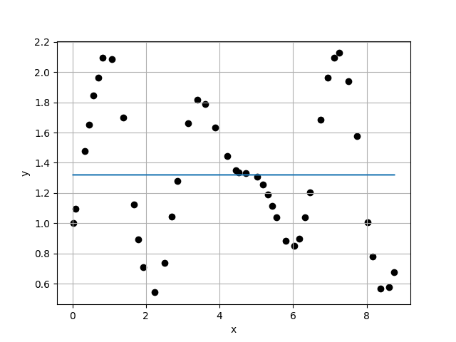
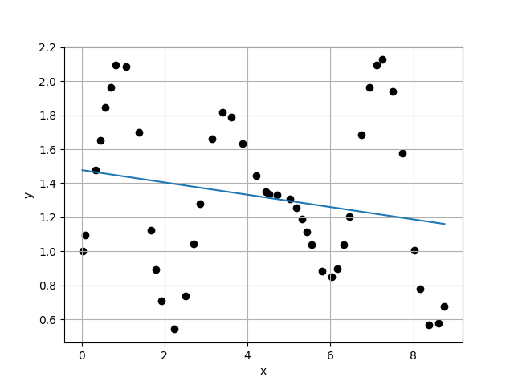
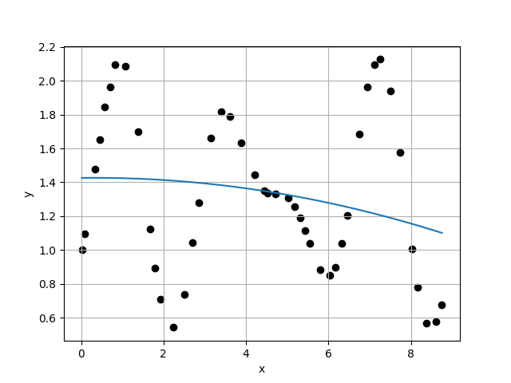
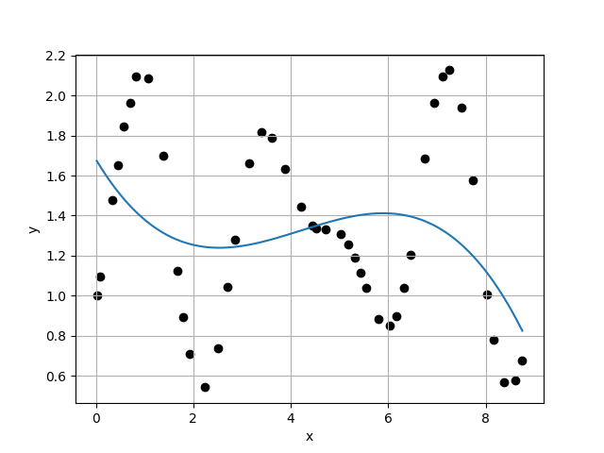








Case 1 :
Case 2 :
f(x) = 1.3200E+00
f(x) = 1.4772E+00 - 3.6178E-02 * x
$σ_{k}=$4.6732E-01
$σ_{k}=$4.6243E-01
$\frac{σ_{k}}{σ_{k+1}}=$1.0106E+00
$\frac{σ_{k}}{σ_{k+1}}=$9.9023E-01
Case 3 :
f(x) = 1.4260E+00 + 2.8636E-03 * x - 4.5716E-03 * x^2
Case 4 :
f(x) = 1.6814E+00 - 4.0739E-01 * x + 1.1501E-01 * x^2 - 9.1013E-03 * x^3
$σ_{k}=$4.6699E-01
$σ_{k}=$4.5387E-01
$\frac{σ_{k}}{σ_{k+1}}=$1.0289E+00
$\frac{σ_{k}}{σ_{k+1}}=$1.0526E+00

Slide 6
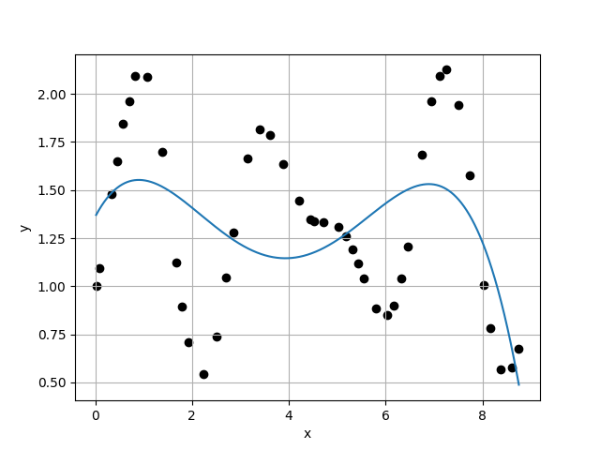
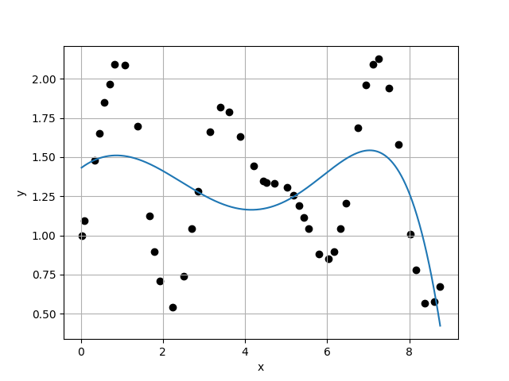
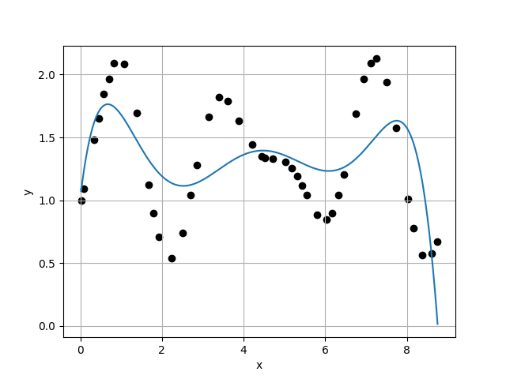
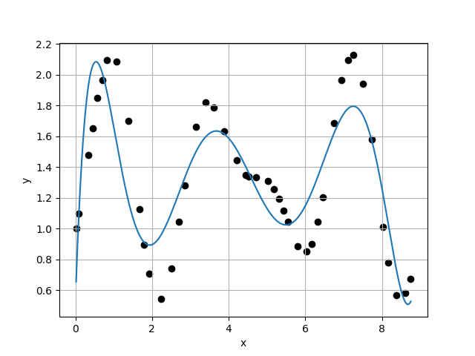








Case 5 :
Case 6 :
f(x) = 1.3611E+00 + 4.8095E-01 * x - 3.6301E-01 * x^2 + 7.7062E-02 * x^3 - 4.9326E-03 * x^4
f(x) = 1.4285E+00 + 1.9678E-01 * x - 1.2338E-01 * x^2 + 2.8552E-03 * x^3 + 4.6400E-03 * x^4 - 4.3659E-04 * x^5
$σ_{k}=$4.3121E-01
$σ_{k}=$4.3553E-01
$\frac{σ_{k}}{σ_{k+1}}=$9.9007E-01
$\frac{σ_{k}}{σ_{k+1}}=$1.1226E+00
Case 7 :
f(x) = 1.0190E+00 + 2.7100E+00 * x - 3.2470E+00 * x^2 + 1.4870E+00 * x^3 - 3.1961E-01 * x^4 + 3.2487E-02 * x^5 - 1.2590E-03 * x^6
Case 8 :
f(x) = 5.1413E-01 + 7.2331E+00 * x - 1.1132E+01 * x^2 + 6.7832E+00 * x^3 - 2.0319E+00 * x^4 + 3.1839E-01 * x^5 - 2.5021E-02 * x^6 + 7.7774E-04 * x^7
$σ_{k}=$3.8798E-01
$σ_{k}=$2.6512E-01
$\frac{σ_{k}}{σ_{k+1}}=$1.4634E+00
$\frac{σ_{k}}{σ_{k+1}}=$1.4120E+00

Slide 7
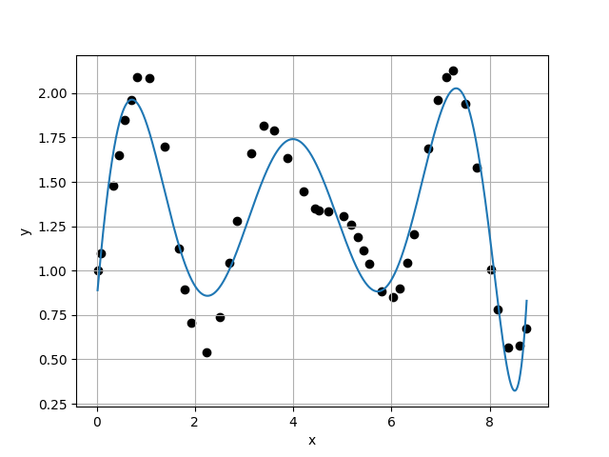
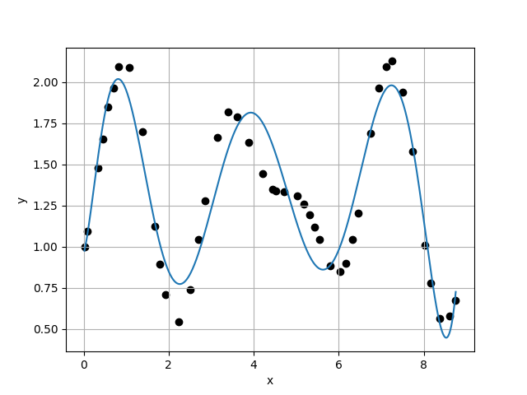
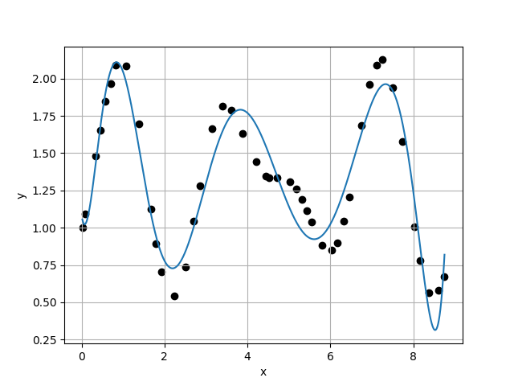
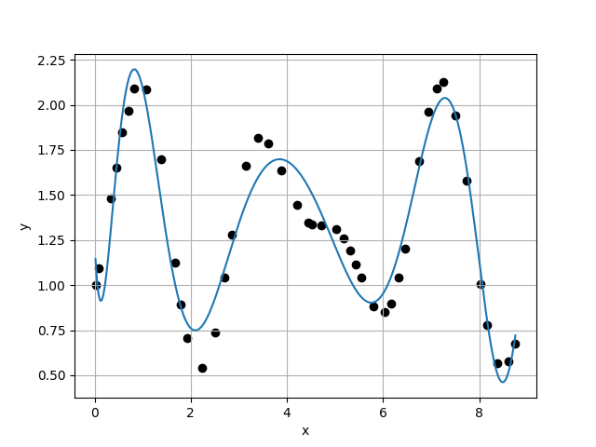








Case 9 :
Case 10 :
f(x) = 8.2613E-01 + 3.2037E+00 * x - 1.8051E+00 * x^2 - 1.5566E+00 * x^3 + 1.6610E+00 * x^4 - 5.7466E-01 * x^5 + 9.5088E-02 * x^6 - 7.6567E-03 * x^7 + 2.4107E-04 * x^8
f(x) = 9.5304E-01 + 1.0175E+00 * x + 4.4821E+00 * x^2 - 8.6330E+00 * x^3 + 5.7024E+00 * x^4 - 1.8830E+00 * x^5 + 3.4550E-01 * x^6 - 3.5716E-02 * x^7 + 1.9422E-03 * x^8 - 4.3076E-05 * x^9
$σ_{k}=$1.8776E-01
$σ_{k}=$1.7596E-01
$\frac{σ_{k}}{σ_{k+1}}=$1.0671E+00
$\frac{σ_{k}}{σ_{k+1}}=$1.0695E+00
Case 11 :
f(x) = 1.0858E+00 - 1.7702E+00 * x + 1.4025E+01 * x^2 - 2.1718E+01 * x^3 + 1.5014E+01 * x^4 - 5.7427E+00 * x^5 + 1.3287E+00 * x^6 - 1.9172E-01 * x^7 + 1.6969E-02 * x^8 - 8.4711E-04 * x^9 + 1.8328E-05 * x^10
Case 12 :
f(x) = 1.2479E+00 - 5.7628E+00 * x + 3.0197E+01 * x^2 - 4.8526E+01 * x^3 + 3.8422E+01 * x^4 - 1.7853E+01 * x^5 + 5.2719E+00 * x^6 - 1.0216E+00 * x^7 + 1.2967E-01 * x^8 - 1.0380E-02 * x^9 + 4.7514E-04 * x^10 - 9.4693E-06 * x^11
$σ_{k}=$1.6453E-01
$σ_{k}=$1.4735E-01
$\frac{σ_{k}}{σ_{k+1}}=$1.1166E+00
$\frac{σ_{k}}{σ_{k+1}}=$1.3013E+00

Slide 8
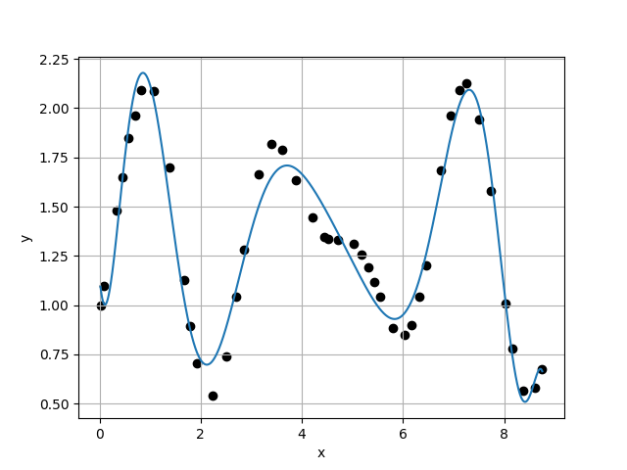
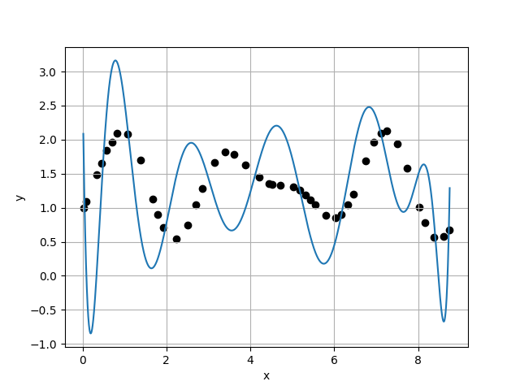
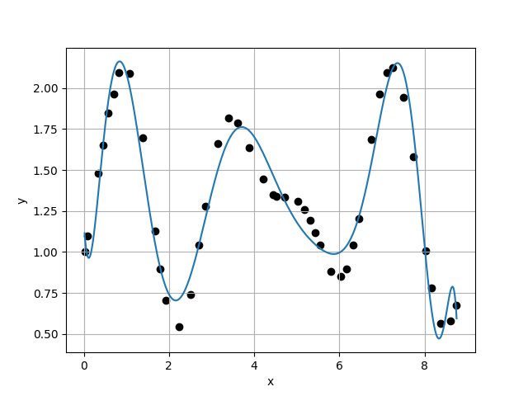
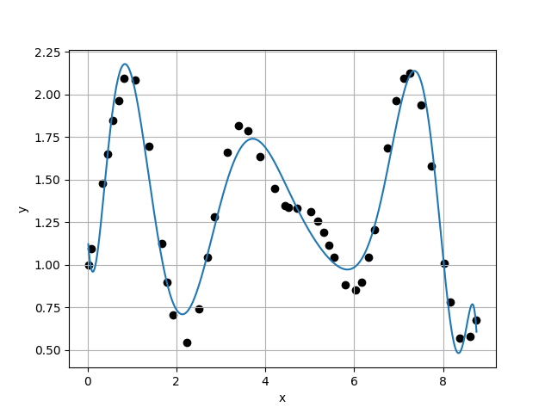








Case 13 :
f(x) = 1.1439E+00 - 2.8204E+00 * x + 1.6112E+01 * x^2 - 2.0557E+01 * x^3 + 8.9268E+00 * x^4 + 7.7599E-01 * x^5 - 2.2544E+00 * x^6 + 9.9205E-01 * x^7 - 2.3123E-01 * x^8 + 3.2470E-02 * x^9 - 2.7586E-03 * x^10 + 1.3096E-04 * x^11 - 2.6715E-06 * x^12
Case 14 :
f(x) = 2.9550E+00 - 4.7223E+01 * x + 1.9227E+02 * x^2 - 2.9697E+02 * x^3 + 2.2073E+02 * x^4 - 7.8290E+01 * x^5 + 4.1742E+00 * x^6 + 7.6684E+00 * x^7 - 3.4137E+00 * x^8 + 7.4949E-01 * x^9 - 9.8323E-02 * x^10 + 7.8159E-03 * x^11 - 3.4852E-04 * x^12 + 6.7081E-06 * x^13
$σ_{k}=$1.1324E-01
$σ_{k}=$8.9219E-01
$\frac{σ_{k}}{σ_{k+1}}=$1.2692E-01
$\frac{σ_{k}}{σ_{k+1}}=$6.6053E+00
Case 15 :
f(x) = 1.1915E+00 - 4.3549E+00 * x + 2.5018E+01 * x^2 - 4.2076E+01 * x^3 + 3.6416E+01 * x^4 - 2.0113E+01 * x^5 + 7.8157E+00 * x^6 - 2.1848E+00 * x^7 + 4.2588E-01 * x^8 - 5.3099E-02 * x^9 + 3.2137E-03 * x^10 + 1.0129E-04 * x^11 - 3.3074E-05 * x^12 + 2.2509E-06 * x^13 - 5.4716E-08 * x^14
Case 16 :
f(x) = 1.1993E+00 - 4.4289E+00 * x + 2.4390E+01 * x^2 - 3.8563E+01 * x^3 + 2.9917E+01 * x^4 - 1.3885E+01 * x^5 + 4.2362E+00 * x^6 - 8.6642E-01 * x^7 + 1.0676E-01 * x^8 - 2.9895E-03 * x^9 - 1.4743E-03 * x^10 + 2.6741E-04 * x^11 - 1.8395E-05 * x^12 + 1.1367E-07 * x^13 + 5.0999E-08 * x^14 - 1.9737E-09 * x^15
$σ_{k}=$1.3507E-01
$σ_{k}=$1.3624E-01
$\frac{σ_{k}}{σ_{k+1}}=$9.9143E-01
$\frac{σ_{k}}{σ_{k+1}}=$1.2006E+00

Slide 9
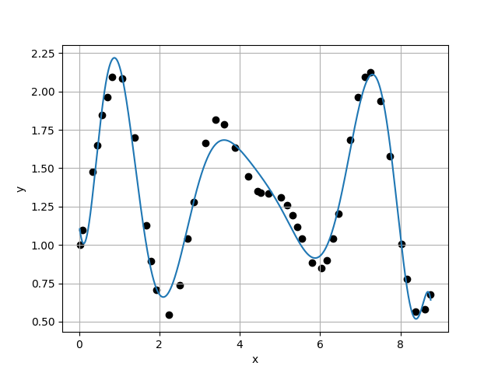
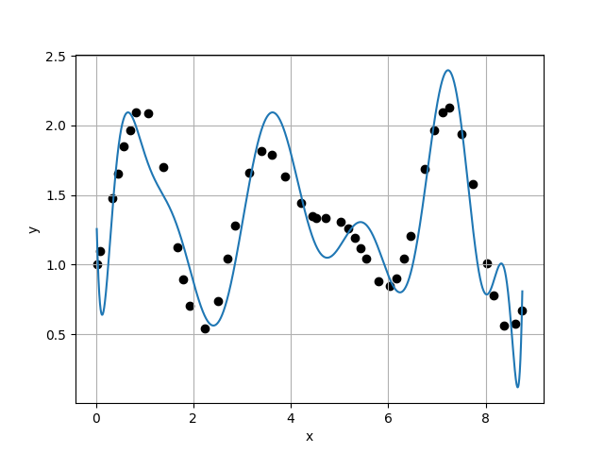
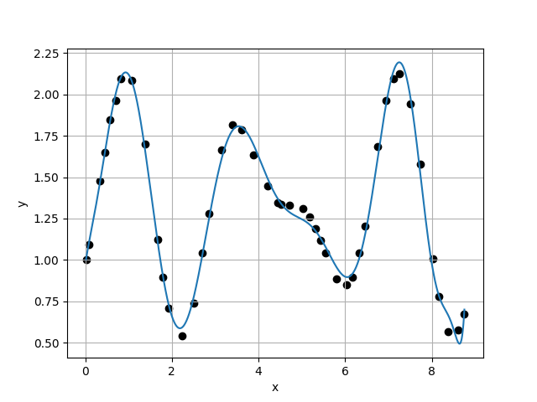
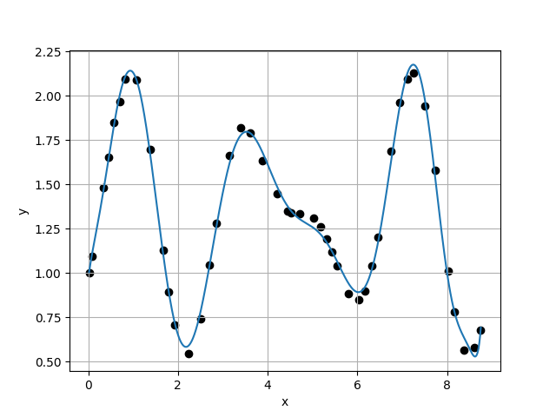








Case 17 :
Case 18 :
f(x) = 1.1507E+00 - 2.5800E+00 * x + 1.3120E+01 * x^2 - 1.1683E+01 * x^3 - 2.4873E+00 * x^4 + 8.3826E+00 * x^5 - 4.8962E+00 * x^6 + 1.2948E+00 * x^7 - 1.1216E-01 * x^8 - 2.6698E-02 * x^9 + 8.9034E-03 * x^10 - 9.5171E-04 * x^11 - 1.9489E-06 * x^12 + 1.1176E-05 * x^13 - 1.2227E-06 * x^14 + 5.8961E-08 * x^15 - 1.1311E-09 * x^16
f(x) = 1.5568E+00 - 1.7003E+01 * x + 1.0320E+02 * x^2 - 2.4048E+02 * x^3 + 3.0030E+02 * x^4 - 2.2763E+02 * x^5 + 1.1066E+02 * x^6 - 3.5198E+01 * x^7 + 7.2338E+00 * x^8 - 8.9182E-01 * x^9 + 4.6054E-02 * x^10 + 3.6542E-03 * x^11 - 9.3946E-04 * x^12 + 1.1646E-04 * x^13 - 1.3153E-05 * x^14 + 1.1743E-06 * x^15 - 6.1611E-08 * x^16 + 1.3584E-09 * x^17
$σ_{k}=$1.1347E-01
$σ_{k}=$2.7911E-01
$\frac{σ_{k}}{σ_{k+1}}=$4.0655E-01
$\frac{σ_{k}}{σ_{k+1}}=$5.0738E+00
Case 19 :
f(x) = 9.7055E-01 + 1.7378E+00 * x - 3.1933E+00 * x^2 + 1.1696E+01 * x^3 - 1.7404E+01 * x^4 + 1.1619E+01 * x^5 - 3.8903E+00 * x^6 + 5.9932E-01 * x^7 - 6.6405E-03 * x^8 - 9.0267E-03 * x^9 + 4.3736E-04 * x^10 + 1.1965E-04 * x^11 - 1.3066E-05 * x^12 + 1.1409E-06 * x^13 - 2.5799E-07 * x^14 + 1.4442E-08 * x^15 + 2.6265E-09 * x^16 - 3.4320E-10 * x^17 + 1.1322E-11 * x^18
Case 20 :
f(x) = 9.6785E-01 + 1.8723E+00 * x - 4.0521E+00 * x^2 + 1.3606E+01 * x^3 - 1.9275E+01 * x^4 + 1.2392E+01 * x^5 - 3.8588E+00 * x^6 + 4.3725E-01 * x^7 + 6.1604E-02 * x^8 - 2.2206E-02 * x^9 + 1.5062E-03 * x^10 + 1.3113E-04 * x^11 - 1.6118E-05 * x^12 + 5.6144E-07 * x^13 - 2.6711E-07 * x^14 + 2.1608E-08 * x^15 + 5.1231E-09 * x^16 - 9.2345E-10 * x^17 + 5.4083E-11 * x^18 - 1.1064E-12 * x^19
$σ_{k}=$5.5010E-02
$σ_{k}=$4.4553E-02
$\frac{σ_{k}}{σ_{k+1}}=$1.2347E+00
$\frac{σ_{k}}{σ_{k+1}}=$3.6640E-01

Slide 10
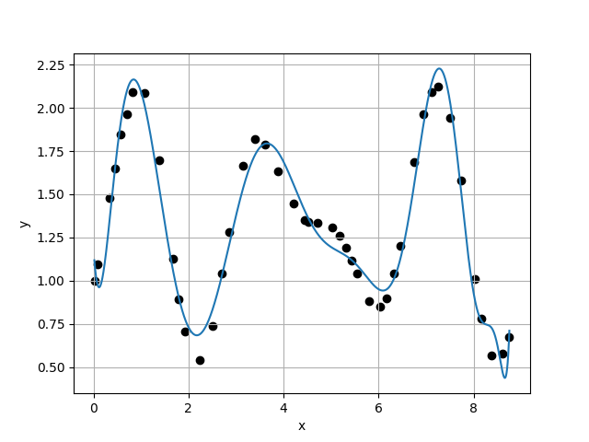
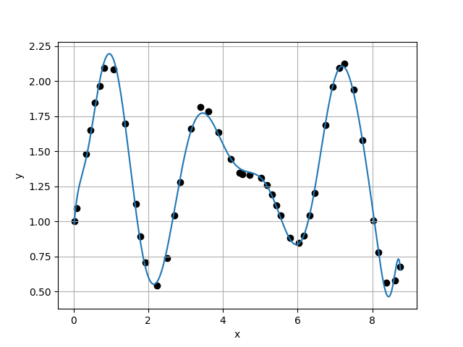
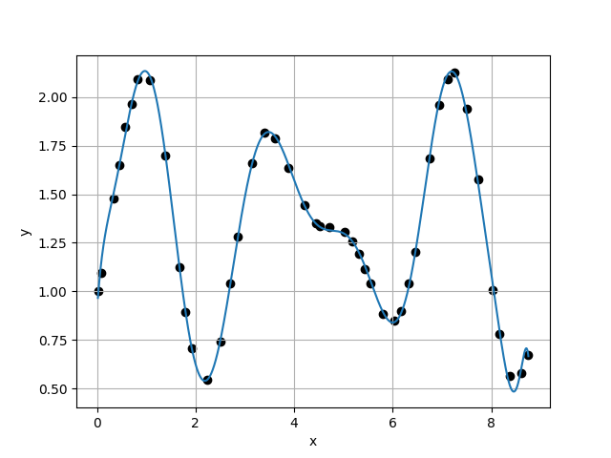
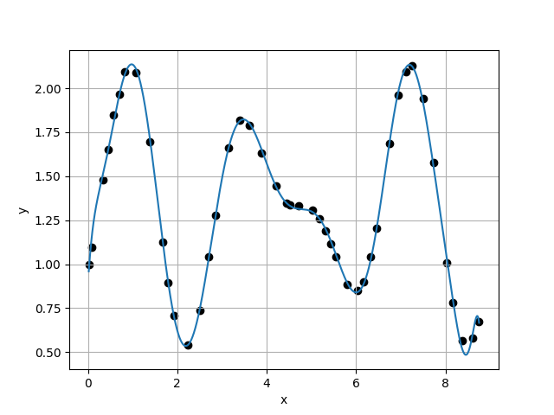








Case 21 :
Case 22 :
f(x) = 1.1971E+00 - 4.4352E+00 * x + 2.5143E+01 * x^2 - 4.1765E+01 * x^3 + 3.5107E+01 * x^4 - 1.8082E+01 * x^5 + 6.0795E+00 * x^6 - 1.2962E+00 * x^7 + 1.4852E-01 * x^8 - 2.5290E-03 * x^9 - 1.0919E-03 * x^10 - 1.1200E-05 * x^11 + 2.4294E-05 * x^12 - 2.4062E-06 * x^13 + 3.9689E-08 * x^14 + 5.3569E-08 * x^15 - 1.5099E-08 * x^16 + 1.6505E-09 * x^17 - 5.6588E-11 * x^18 - 2.1302E-12 * x^19 + 1.4161E-13 * x^20
f(x) = 9.1130E-01 + 3.9883E+00 * x - 1.7658E+01 * x^2 + 4.9207E+01 * x^3 - 6.8607E+01 * x^4 + 5.3836E+01 * x^5 - 2.6621E+01 * x^6 + 8.9204E+00 * x^7 - 2.0892E+00 * x^8 + 3.3115E-01 * x^9 - 2.9397E-02 * x^10 - 3.6985E-05 * x^11 + 2.8155E-04 * x^12 - 9.0924E-06 * x^13 - 3.4722E-06 * x^14 + 3.1329E-07 * x^15 + 1.0882E-08 * x^16 - 2.5194E-09 * x^17 + 1.6047E-10 * x^18 - 1.6530E-11 * x^19 + 1.4518E-12 * x^20 - 4.5826E-14 * x^21
$σ_{k}=$1.2159E-01
$σ_{k}=$4.9168E-02
$\frac{σ_{k}}{σ_{k+1}}=$2.4730E+00
$\frac{σ_{k}}{σ_{k+1}}=$1.6871E+00
Case 23 :
f(x) = 8.9555E-01 + 3.7718E+00 * x - 1.2220E+01 * x^2 + 2.7663E+01 * x^3 - 3.1421E+01 * x^4 + 1.8109E+01 * x^5 - 5.3070E+00 * x^6 + 6.0390E-01 * x^7 + 5.9007E-02 * x^8 - 2.1808E-02 * x^9 + 1.1722E-03 * x^10 + 1.3100E-04 * x^11 - 7.6800E-06 * x^12 - 8.5752E-07 * x^13 + 1.0231E-07 * x^14 - 1.6236E-08 * x^15 - 1.1984E-09 * x^16 + 3.6072E-10 * x^17 + 4.1009E-11 * x^18 - 6.4732E-12 * x^19 - 5.6029E-13 * x^20 + 1.0455E-13 * x^21 - 3.7802E-15 * x^22
Case 24 :
f(x) = 8.8130E-01 + 4.1687E+00 * x - 1.4157E+01 * x^2 + 3.1708E+01 * x^3 - 3.6081E+01 * x^4 + 2.1473E+01 * x^5 - 6.9460E+00 * x^6 + 1.1649E+00 * x^7 - 7.6380E-02 * x^8 - 2.1857E-04 * x^9 - 4.8523E-04 * x^10 + 1.5673E-05 * x^11 + 2.9020E-05 * x^12 - 1.2468E-06 * x^13 - 6.3182E-07 * x^14 + 6.3757E-08 * x^15 - 2.5137E-11 * x^16 - 8.9329E-11 * x^17 + 1.5577E-12 * x^18 + 4.2028E-13 * x^19 - 3.0868E-13 * x^20 + 1.4666E-14 * x^21 + 1.9430E-15 * x^22 - 1.2318E-16 * x^23
$σ_{k}=$2.9143E-02
$σ_{k}=$3.1522E-02
$\frac{σ_{k}}{σ_{k+1}}=$9.2454E-01
$\frac{σ_{k}}{σ_{k+1}}=$3.1180E-01

Slide 11
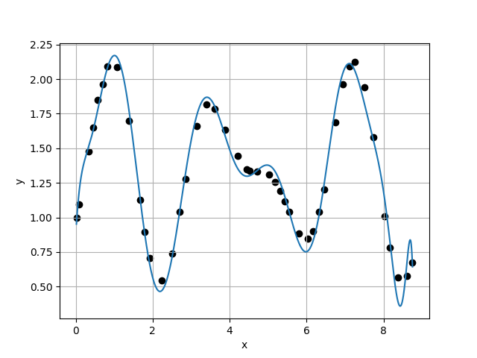
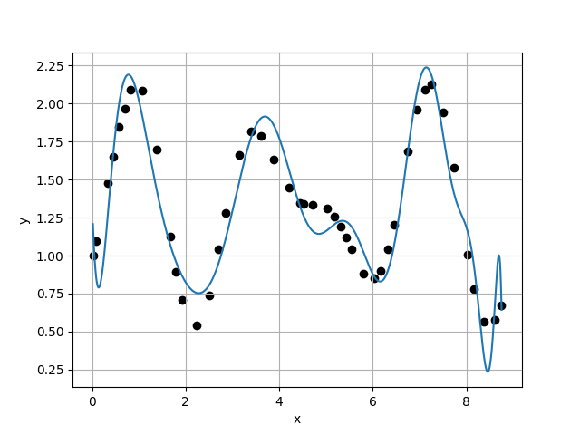
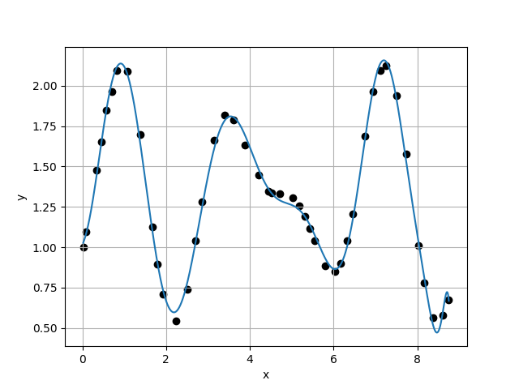
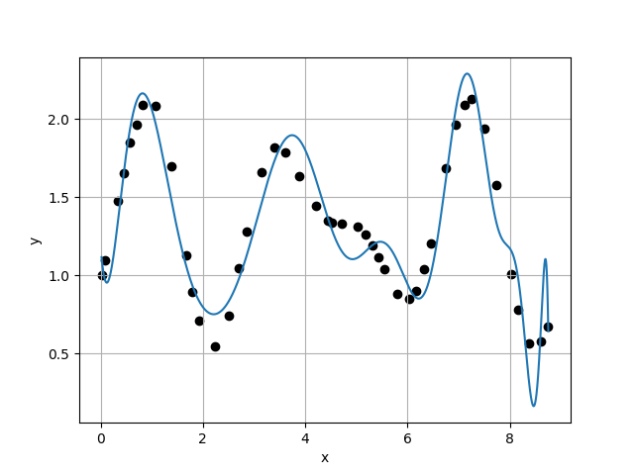








Case 25 :
f(x) = 8.5895E-01 + 5.0363E+00 * x - 1.8938E+01 * x^2 + 4.2014E+01 * x^3 - 4.8118E+01 * x^4 + 3.1058E+01 * x^5 - 1.2940E+01 * x^6 + 4.0977E+00 * x^7 - 1.1019E+00 * x^8 + 2.3001E-01 * x^9 - 2.7932E-02 * x^10 + 3.7983E-04 * x^11 + 2.8818E-04 * x^12 - 8.2058E-07 * x^13 - 6.7785E-06 * x^14 + 5.0416E-07 * x^15 + 3.8156E-08 * x^16 - 3.3527E-09 * x^17 - 5.6966E-10 * x^18 + 6.1033E-11 * x^19 + 5.4968E-12 * x^20 - 1.5455E-12 * x^21 + 1.4053E-13 * x^22 - 6.2289E-15 * x^23 + 1.1101E-16 * x^24
Case 26 :
f(x) = 1.3827E+00 - 9.7435E+00 * x + 5.0491E+01 * x^2 - 9.0205E+01 * x^3 + 8.0841E+01 * x^4 - 4.0314E+01 * x^5 + 1.0545E+01 * x^6 - 7.1548E-01 * x^7 - 3.3884E-01 * x^8 + 8.4478E-02 * x^9 - 2.3990E-03 * x^10 - 1.2888E-03 * x^11 + 1.2216E-04 * x^12 - 7.1100E-08 * x^13 + 6.8824E-07 * x^14 - 8.7698E-08 * x^15 - 1.3675E-08 * x^16 + 2.3808E-09 * x^17 - 3.0988E-10 * x^18 + 2.9268E-11 * x^19 + 1.1440E-12 * x^20 - 4.5400E-14 * x^21 - 5.1554E-14 * x^22 + 3.3932E-15 * x^23 + 1.4127E-16 * x^24 - 1.1861E-17 * x^25
$σ_{k}=$1.0110E-01
$σ_{k}=$2.1766E-01
$\frac{σ_{k}}{σ_{k+1}}=$4.6446E-01
$\frac{σ_{k}}{σ_{k+1}}=$4.0591E+00
Case 27 :
f(x) = 1.0147E+00 + 5.6445E-01 * x + 2.0900E+00 * x^2 + 1.9521E+00 * x^3 - 8.2328E+00 * x^4 + 6.9494E+00 * x^5 - 2.7490E+00 * x^6 + 6.0803E-01 * x^7 - 8.8290E-02 * x^8 + 1.1196E-02 * x^9 - 1.1851E-03 * x^10 + 3.3573E-05 * x^11 + 2.0308E-06 * x^12 + 1.7674E-06 * x^13 - 2.8748E-07 * x^14 - 2.9132E-10 * x^15 + 2.4480E-09 * x^16 - 2.3244E-10 * x^17 + 1.8818E-11 * x^18 - 2.4406E-12 * x^19 + 4.4033E-13 * x^20 - 3.7353E-14 * x^21 + 1.0476E-15 * x^22 + 2.3789E-17 * x^23 - 3.6582E-17 * x^24 + 5.6206E-18 * x^25 - 2.3306E-19 * x^26
Case 28 :
f(x) = 1.1953E+00 - 4.4275E+00 * x + 2.3934E+01 * x^2 - 3.4569E+01 * x^3 + 1.9460E+01 * x^4 - 1.2458E+00 * x^5 - 4.0135E+00 * x^6 + 2.1851E+00 * x^7 - 5.0269E-01 * x^8 + 4.4499E-02 * x^9 + 1.2082E-03 * x^10 - 1.2695E-05 * x^11 - 1.0498E-04 * x^12 + 7.5137E-06 * x^13 + 5.7773E-08 * x^14 + 1.5625E-07 * x^15 - 1.6533E-08 * x^16 - 3.1916E-10 * x^17 - 1.5975E-10 * x^18 + 1.4347E-11 * x^19 + 2.7873E-12 * x^20 - 8.9513E-14 * x^21 - 1.4520E-14 * x^22 - 8.7470E-16 * x^23 + 7.3877E-17 * x^24 - 1.1947E-17 * x^25 + 2.9737E-18 * x^26 - 1.5001E-19 * x^27
$σ_{k}=$5.3623E-02
$σ_{k}=$2.3163E-01
$\frac{σ_{k}}{σ_{k+1}}=$2.3151E-01
$\frac{σ_{k}}{σ_{k+1}}=$1.8934E+00

Slide 12
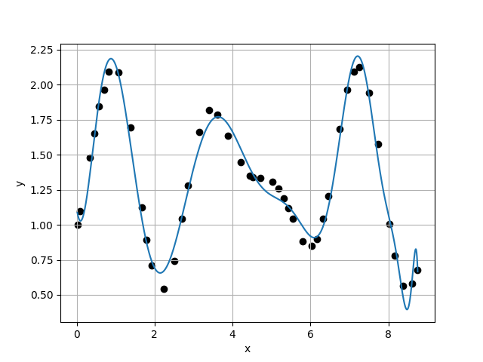
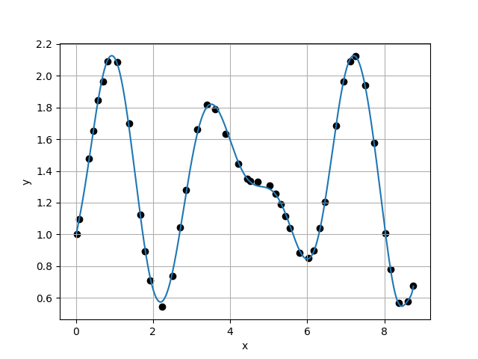
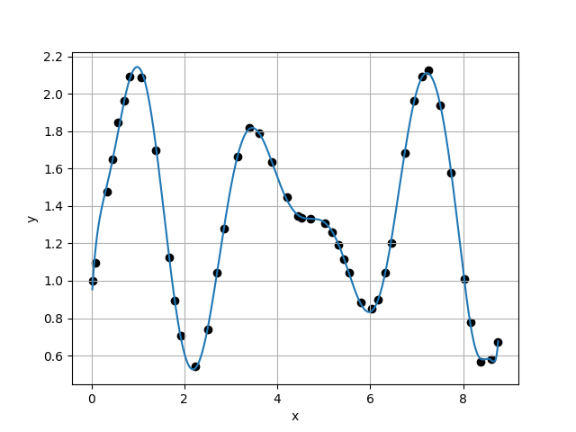
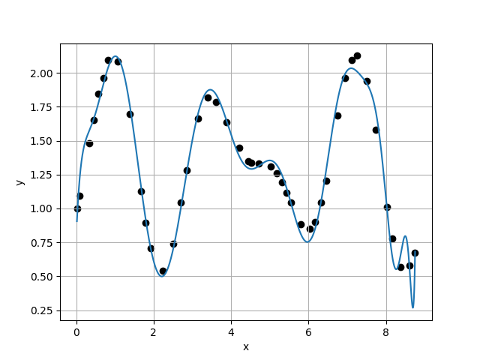








Case 29 :
Case 30 :
f(x) = 1.1211E+00 - 1.9719E+00 * x + 1.1467E+01 * x^2 - 1.0653E+01 * x^3 - 1.7922E+00 * x^4 + 7.4007E+00 * x^5 - 4.6269E+00 * x^6 + 1.3915E+00 * x^7 - 1.9586E-01 * x^8 - 1.6736E-03 * x^9 + 4.7788E-03 * x^10 - 6.0289E-04 * x^11 + 1.5608E-05 * x^12 - 1.9100E-07 * x^13 + 5.1302E-07 * x^14 - 3.7296E-08 * x^15 - 6.9538E-09 * x^16 + 8.0144E-10 * x^17 + 6.3412E-11 * x^18 - 5.0391E-12 * x^19 - 1.5020E-12 * x^20 - 1.0370E-14 * x^21 + 3.0413E-14 * x^22 - 9.9135E-16 * x^23 + 1.2092E-16 * x^24 - 5.9363E-17 * x^25 + 4.6642E-18 * x^26 + 1.0094E-20 * x^27 - 7.5858E-21 * x^28
f(x) = 9.8686E-01 + 1.2224E+00 * x - 1.6485E-01 * x^2 + 4.2569E+00 * x^3 - 7.8945E+00 * x^4 + 4.6664E+00 * x^5 - 8.8693E-01 * x^6 - 1.4447E-01 * x^7 + 8.2347E-02 * x^8 - 9.7362E-03 * x^9 - 1.5554E-04 * x^10 + 6.5347E-05 * x^11 - 8.6564E-07 * x^12 + 6.4958E-07 * x^13 + 1.1834E-08 * x^14 - 1.9437E-08 * x^15 + 2.0298E-10 * x^16 - 4.3971E-11 * x^17 + 1.4500E-11 * x^18 + 1.8577E-12 * x^19 - 3.3381E-14 * x^20 + 1.7891E-14 * x^21 - 5.7382E-15 * x^22 - 2.1468E-16 * x^23 - 1.9993E-17 * x^24 + 1.2340E-17 * x^25 - 1.3257E-19 * x^26 - 2.9356E-20 * x^27 - 5.5410E-21 * x^28 + 3.9304E-22 * x^29
$σ_{k}=$1.2234E-01
$σ_{k}=$2.9251E-02
$\frac{σ_{k}}{σ_{k+1}}=$4.1823E+00
$\frac{σ_{k}}{σ_{k+1}}=$8.9976E-01
Case 31 :
f(x) = 8.6998E-01 + 4.5264E+00 * x - 1.6012E+01 * x^2 + 3.5537E+01 * x^3 - 4.0051E+01 * x^4 + 2.3746E+01 * x^5 - 7.6646E+00 * x^6 + 1.2658E+00 * x^7 - 6.9863E-02 * x^8 - 4.4285E-03 * x^9 - 2.1945E-04 * x^10 + 1.1864E-04 * x^11 + 1.1636E-05 * x^12 - 2.7341E-06 * x^13 + 7.6738E-08 * x^14 - 1.3894E-08 * x^15 + 2.6998E-09 * x^16 + 5.6293E-11 * x^17 - 2.4925E-11 * x^18 - 2.1561E-12 * x^19 + 7.5843E-13 * x^20 - 1.4431E-14 * x^21 - 7.6588E-15 * x^22 + 1.0990E-16 * x^23 + 6.4306E-17 * x^24 - 4.4197E-18 * x^25 + 3.5018E-19 * x^26 - 4.9844E-20 * x^27 + 1.0610E-20 * x^28 - 1.2687E-21 * x^29 + 5.0224E-23 * x^30
Case 32 :
f(x) = 7.7901E-01 + 6.8161E+00 * x - 2.5967E+01 * x^2 + 5.4154E+01 * x^3 - 5.9609E+01 * x^4 + 3.6847E+01 * x^5 - 1.3547E+01 * x^6 + 3.0067E+00 * x^7 - 3.7546E-01 * x^8 + 1.6525E-02 * x^9 + 1.3530E-03 * x^10 + 6.8203E-05 * x^11 - 7.0000E-05 * x^12 + 5.3987E-06 * x^13 + 3.1465E-07 * x^14 + 7.0421E-09 * x^15 - 8.9447E-09 * x^16 + 6.4696E-10 * x^17 - 6.3012E-11 * x^18 - 4.9984E-12 * x^19 + 1.0551E-12 * x^20 + 2.0886E-13 * x^21 - 1.5138E-14 * x^22 - 4.2850E-16 * x^23 - 2.8592E-16 * x^24 + 2.9991E-17 * x^25 - 3.5514E-18 * x^26 + 6.1690E-19 * x^27 - 3.6717E-20 * x^28 + 5.6647E-21 * x^29 - 8.8978E-22 * x^30 + 3.9103E-23 * x^31
$σ_{k}=$3.2510E-02
$σ_{k}=$1.1599E-01
$\frac{σ_{k}}{σ_{k+1}}=$2.8028E-01
$\frac{σ_{k}}{σ_{k+1}}=$1.2240E+00

Slide 13
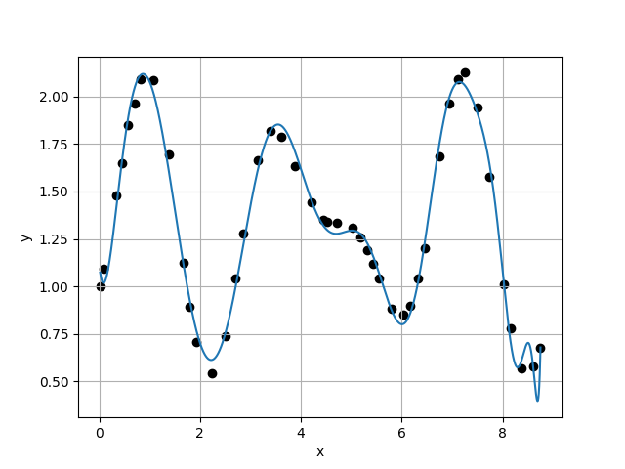
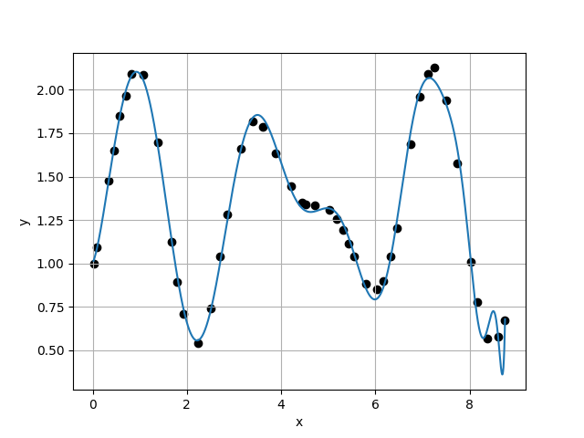
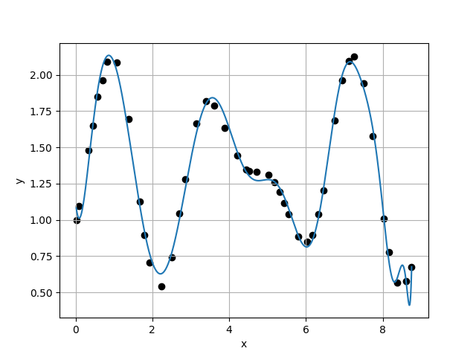
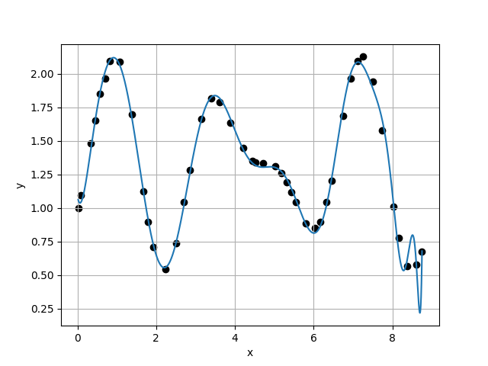








Case 33 :
Case 34 :
f(x) = 1.1150E+00 - 2.4261E+00 * x + 1.7562E+01 * x^2 - 3.1199E+01 * x^3 + 2.8926E+01 * x^4 - 1.7237E+01 * x^5 + 6.7976E+00 * x^6 - 1.6745E+00 * x^7 + 2.2770E-01 * x^8 - 1.3076E-02 * x^9 + 6.3171E-04 * x^10 - 2.3359E-04 * x^11 + 1.6883E-05 * x^12 + 2.5103E-06 * x^13 - 3.0288E-07 * x^14 + 2.6992E-08 * x^15 - 1.4340E-09 * x^16 - 4.0691E-10 * x^17 - 2.3615E-11 * x^18 + 7.2606E-12 * x^19 + 1.2979E-13 * x^20 + 7.1111E-14 * x^21 - 8.2786E-15 * x^22 - 6.2746E-16 * x^23 + 6.4065E-17 * x^24 - 1.4001E-17 * x^25 + 1.1509E-18 * x^26 - 6.6065E-20 * x^27 + 1.5215E-20 * x^28 + 9.8744E-22 * x^29 - 1.3711E-22 * x^30 - 1.8738E-23 * x^31 + 1.4823E-24 * x^32
f(x) = 1.0018E+00 + 5.9743E-01 * x + 4.3179E+00 * x^2 - 8.1364E+00 * x^3 + 9.2735E+00 * x^4 - 8.8575E+00 * x^5 + 5.5480E+00 * x^6 - 2.0212E+00 * x^7 + 4.0777E-01 * x^8 - 4.1258E-02 * x^9 + 2.2029E-03 * x^10 - 3.7136E-04 * x^11 + 5.0689E-05 * x^12 + 3.9898E-06 * x^13 - 7.8103E-07 * x^14 - 7.8128E-08 * x^15 + 9.4272E-09 * x^16 + 8.7514E-10 * x^17 - 4.4065E-11 * x^18 + 3.6843E-12 * x^19 - 2.5128E-12 * x^20 - 1.0013E-13 * x^21 + 5.1885E-14 * x^22 + 8.4173E-16 * x^23 - 4.4949E-16 * x^24 + 5.2904E-18 * x^25 - 5.8806E-19 * x^26 + 4.2728E-20 * x^27 - 1.4355E-20 * x^28 + 6.3772E-21 * x^29 - 2.8760E-22 * x^30 - 1.8565E-23 * x^31 - 5.8031E-25 * x^32 + 1.2047E-25 * x^33
$σ_{k}=$9.4764E-02
$σ_{k}=$7.3789E-02
$\frac{σ_{k}}{σ_{k+1}}=$1.2843E+00
$\frac{σ_{k}}{σ_{k+1}}=$6.8298E-01
Case 35 :
f(x) = 1.1289E+00 - 2.6808E+00 * x + 1.7870E+01 * x^2 - 2.9664E+01 * x^3 + 2.4668E+01 * x^4 - 1.2655E+01 * x^5 + 4.1313E+00 * x^6 - 7.5891E-01 * x^7 + 4.0411E-02 * x^8 + 8.7694E-03 * x^9 - 8.4147E-04 * x^10 - 9.8810E-05 * x^11 - 1.5852E-06 * x^12 + 2.5222E-06 * x^13 - 3.7511E-08 * x^14 + 1.0472E-08 * x^15 - 2.3075E-09 * x^16 - 2.7903E-10 * x^17 - 1.5519E-11 * x^18 + 3.6992E-12 * x^19 + 3.9737E-13 * x^20 + 4.7933E-14 * x^21 - 1.2801E-15 * x^22 - 1.3045E-15 * x^23 + 3.0196E-17 * x^24 - 3.7666E-18 * x^25 + 3.8688E-19 * x^26 + 9.7547E-20 * x^27 - 8.3495E-21 * x^28 + 8.4201E-22 * x^29 - 6.8793E-23 * x^30 + 2.2952E-24 * x^31 + 1.8017E-25 * x^32 - 1.1140E-25 * x^33 + 7.4636E-27 * x^34
Case 36 :
f(x) = 1.0880E+00 - 1.6711E+00 * x + 1.5691E+01 * x^2 - 3.3990E+01 * x^3 + 4.3027E+01 * x^4 - 3.6797E+01 * x^5 + 2.0858E+01 * x^6 - 7.6419E+00 * x^7 + 1.7696E+00 * x^8 - 2.4670E-01 * x^9 + 1.8231E-02 * x^10 - 4.5647E-04 * x^11 - 1.0375E-05 * x^12 + 1.1818E-06 * x^13 - 8.5945E-08 * x^14 + 5.2644E-09 * x^15 - 9.3471E-09 * x^16 + 3.7129E-10 * x^17 + 1.1614E-10 * x^18 + 2.0374E-11 * x^19 - 2.0673E-12 * x^20 - 2.1859E-13 * x^21 - 3.4259E-14 * x^22 + 2.7188E-15 * x^23 + 6.6643E-16 * x^24 - 4.6442E-17 * x^25 + 1.4144E-17 * x^26 - 1.3721E-18 * x^27 - 1.6914E-19 * x^28 + 5.9911E-21 * x^29 + 2.2320E-21 * x^30 - 8.0209E-23 * x^31 + 1.4869E-25 * x^32 - 2.0208E-25 * x^33 - 7.1226E-26 * x^34 + 5.4430E-27 * x^35
$σ_{k}=$1.0804E-01
$σ_{k}=$8.2947E-02
$\frac{σ_{k}}{σ_{k+1}}=$1.3025E+00
$\frac{σ_{k}}{σ_{k+1}}=$6.4069E-01

Slide 14
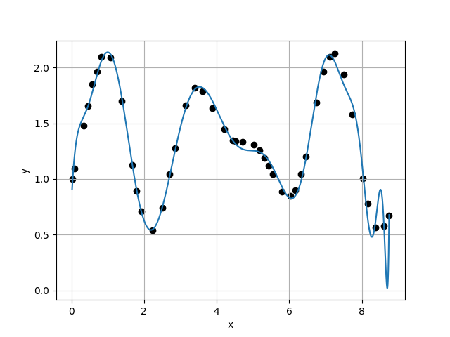
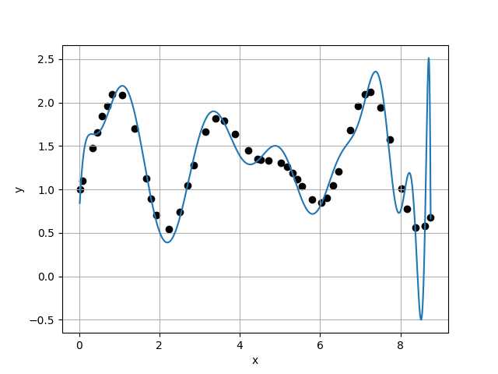
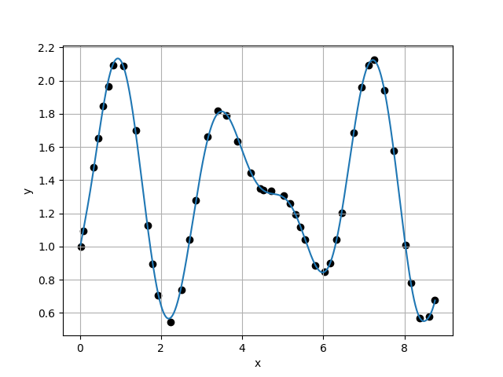
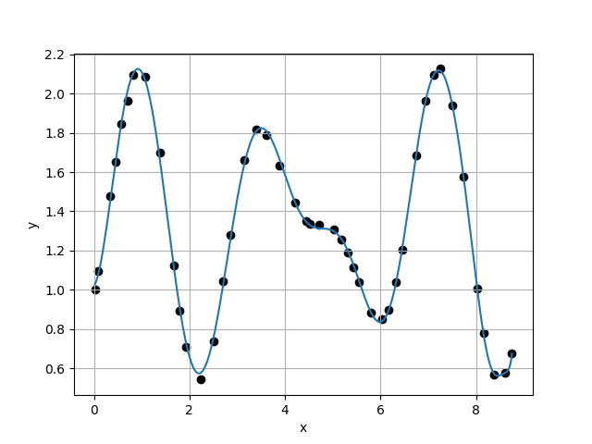








Case 37 :
Case 38 :
f(x) = 7.8155E-01 + 6.9313E+00 * x - 2.7614E+01 * x^2 + 5.9551E+01 * x^3 - 6.6867E+01 * x^4 + 4.1305E+01 * x^5 - 1.4420E+01 * x^6 + 2.6126E+00 * x^7 - 1.0576E-01 * x^8 - 4.5384E-02 * x^9 + 6.9607E-03 * x^10 - 3.7898E-05 * x^11 - 1.4790E-05 * x^12 - 1.2580E-05 * x^13 + 2.1683E-06 * x^14 - 9.0685E-08 * x^15 - 1.0383E-08 * x^16 + 2.0053E-09 * x^17 - 1.9392E-10 * x^18 + 1.9824E-11 * x^19 - 8.2295E-13 * x^20 + 3.7054E-15 * x^21 - 4.6301E-14 * x^22 + 3.8636E-15 * x^23 + 1.8921E-16 * x^24 + 3.6509E-17 * x^25 - 5.3343E-18 * x^26 + 4.0796E-19 * x^27 - 8.3062E-20 * x^28 - 2.2851E-21 * x^29 + 6.4259E-22 * x^30 - 5.3411E-23 * x^31 + 1.4956E-23 * x^32 - 1.0103E-25 * x^33 - 9.6169E-26 * x^34 - 4.7735E-27 * x^35 + 6.1073E-28 * x^36
f(x) = 6.4564E-01 + 1.0713E+01 * x - 4.4221E+01 * x^2 + 8.8224E+01 * x^3 - 9.1732E+01 * x^4 + 5.3955E+01 * x^5 - 1.9105E+01 * x^6 + 4.2648E+00 * x^7 - 6.3558E-01 * x^8 + 6.9513E-02 * x^9 - 5.9315E-03 * x^10 + 3.8182E-04 * x^11 - 2.5704E-05 * x^12 - 1.0513E-07 * x^13 + 5.9766E-07 * x^14 + 8.3525E-09 * x^15 - 1.9097E-08 * x^16 + 2.2641E-09 * x^17 - 8.0852E-11 * x^18 - 1.3391E-11 * x^19 + 3.4085E-13 * x^20 - 1.4006E-13 * x^21 + 8.3393E-14 * x^22 - 1.7484E-15 * x^23 - 5.0681E-16 * x^24 + 2.5118E-17 * x^25 - 7.0679E-18 * x^26 - 1.3170E-18 * x^27 + 1.4271E-19 * x^28 + 9.8764E-21 * x^29 + 1.4249E-21 * x^30 + 4.0120E-23 * x^31 - 1.7920E-23 * x^32 - 2.3205E-24 * x^33 - 2.6427E-25 * x^34 + 3.9485E-26 * x^35 + 3.5574E-27 * x^36 - 3.1432E-28 * x^37
$σ_{k}=$1.2946E-01
$σ_{k}=$3.4293E-01
$\frac{σ_{k}}{σ_{k+1}}=$3.7752E-01
$\frac{σ_{k}}{σ_{k+1}}=$1.0568E+01
Case 39 :
Case 40 :
f(x) = 9.8283E-01 + 1.3903E+00 * x - 1.1633E+00 * x^2 + 6.4816E+00 * x^3 - 1.0349E+01 * x^4 + 6.2451E+00 * x^5 - 1.5746E+00 * x^6 + 9.4847E-02 * x^7 + 1.0941E-02 * x^8 + 6.3885E-03 * x^9 - 2.3599E-03 * x^10 + 1.9007E-04 * x^11 - 2.9508E-06 * x^12 + 2.8688E-06 * x^13 - 4.2368E-07 * x^14 + 6.4815E-09 * x^15 - 1.7260E-09 * x^16 + 2.3934E-10 * x^17 + 2.1740E-11 * x^18 - 2.1495E-12 * x^19 + 3.6554E-13 * x^20 - 5.4080E-15 * x^21 - 6.6295E-15 * x^22 - 4.2881E-16 * x^23 + 2.6865E-17 * x^24 + 1.0049E-17 * x^25 + 4.2485E-19 * x^26 + 6.4083E-21 * x^27 - 2.1099E-20 * x^28 + 7.4019E-22 * x^29 - 6.9013E-23 * x^30 + 1.7572E-23 * x^31 + 1.3093E-24 * x^32 - 2.9846E-25 * x^33 + 5.3821E-27 * x^34 - 4.1577E-28 * x^35 + 2.0690E-28 * x^36 - 1.4521E-29 * x^37 + 2.6073E-31 * x^38
f(x) = 1.0203E+00 + 2.8974E-01 * x + 4.4080E+00 * x^2 - 5.1497E+00 * x^3 + 2.2843E+00 * x^4 - 1.6475E+00 * x^5 + 1.3628E+00 * x^6 - 5.4622E-01 * x^7 + 8.9768E-02 * x^8 - 1.3853E-03 * x^9 - 5.4740E-04 * x^10 - 1.5174E-04 * x^11 + 1.6786E-05 * x^12 + 3.3136E-06 * x^13 - 1.4050E-07 * x^14 - 4.8510E-08 * x^15 + 5.2152E-10 * x^16 - 1.3732E-10 * x^17 + 4.9782E-11 * x^18 + 4.7184E-12 * x^19 + 1.6039E-13 * x^20 - 4.3100E-14 * x^21 - 1.3465E-14 * x^22 - 6.6716E-16 * x^23 + 2.0000E-16 * x^24 + 9.9297E-18 * x^25 - 4.8023E-20 * x^26 - 2.0435E-19 * x^27 + 9.1803E-23 * x^28 - 2.7675E-22 * x^29 + 2.7466E-22 * x^30 - 1.1759E-23 * x^31 + 1.2585E-24 * x^32 - 6.0760E-25 * x^33 + 4.5197E-26 * x^34 + 6.2002E-28 * x^35 + 2.1840E-29 * x^36 - 4.9269E-30 * x^37 - 1.4794E-30 * x^38 + 9.2645E-32 * x^39
$σ_{k}=$3.2449E-02
$σ_{k}=$5.1073E-02
$\frac{σ_{k}}{σ_{k+1}}=$6.3533E-01
$\frac{σ_{k}}{σ_{k+1}}=$9.4716E-01

Slide 15
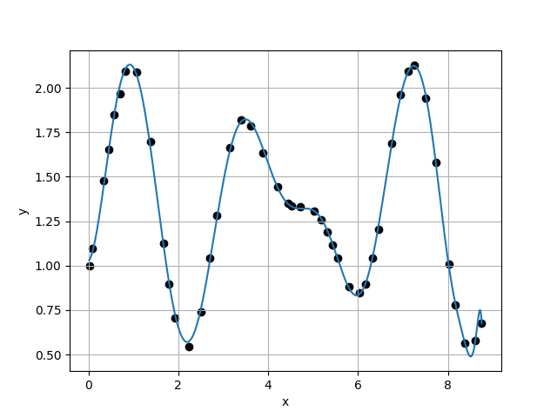
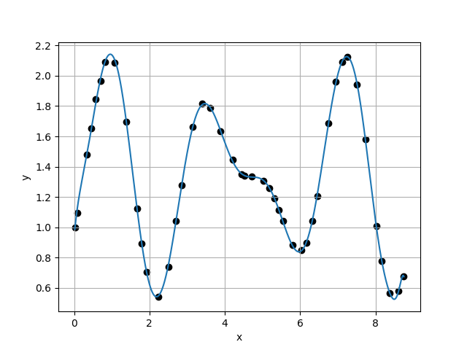
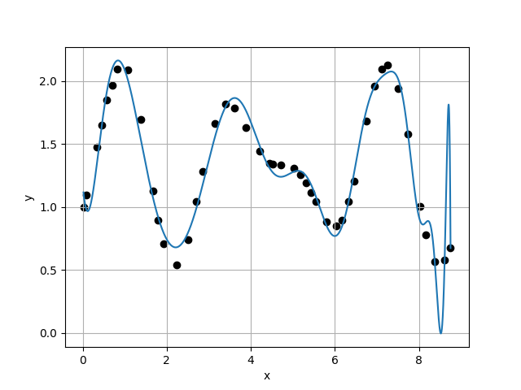
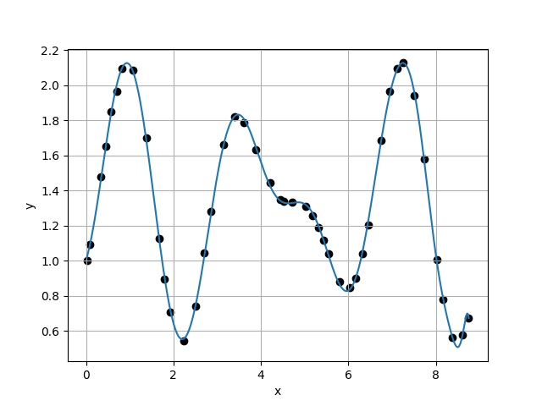






Case 41 :
Case 42 :
f(x) = 1.0249E+00 + 2.1445E-01 * x + 4.5613E+00 * x^2 - 5.1253E+00 * x^3 + 1.9864E+00 * x^4 - 1.3184E+00 * x^5 + 1.1810E+00 * x^6 - 4.8615E-01 * x^7 + 7.7306E-02 * x^8 + 1.0903E-04 * x^9 - 4.7282E-04 * x^10 - 2.7207E-04 * x^11 + 5.4393E-05 * x^12 - 1.6407E-06 * x^13 - 1.2694E-07 * x^14 + 4.1298E-09 * x^15 - 1.6152E-09 * x^16 - 7.3512E-11 * x^17 + 1.0657E-11 * x^18 + 2.0780E-12 * x^19 + 4.4051E-13 * x^20 - 5.3985E-14 * x^21 + 2.6131E-15 * x^22 + 2.1449E-16 * x^23 - 1.3057E-16 * x^24 - 3.0694E-18 * x^25 + 5.2980E-19 * x^26 + 1.1599E-19 * x^27 + 1.2184E-20 * x^28 - 1.5046E-21 * x^29 - 2.6165E-22 * x^30 + 5.7248E-23 * x^31 - 4.1891E-24 * x^32 - 6.9021E-26 * x^33 + 4.7443E-26 * x^34 - 8.5961E-27 * x^35 + 4.7823E-28 * x^36 + 2.7315E-29 * x^37 + 6.6620E-31 * x^38 - 4.7103E-31 * x^39 + 1.8893E-32 * x^40
f(x) = 9.3634E-01 + 2.7379E+00 * x - 7.7185E+00 * x^2 + 1.9542E+01 * x^3 - 2.3862E+01 * x^4 + 1.4297E+01 * x^5 - 4.4234E+00 * x^6 + 6.5978E-01 * x^7 - 3.0069E-02 * x^8 - 2.6079E-04 * x^9 - 5.8379E-04 * x^10 + 4.8493E-05 * x^11 + 3.5811E-06 * x^12 + 9.9878E-07 * x^13 - 6.9396E-08 * x^14 - 2.6022E-08 * x^15 + 1.2430E-09 * x^16 + 2.4504E-11 * x^17 + 3.7801E-12 * x^18 + 2.1140E-12 * x^19 + 7.0036E-14 * x^20 - 3.4374E-14 * x^21 + 2.6726E-15 * x^22 - 6.0649E-16 * x^23 + 5.2213E-17 * x^24 - 2.1310E-18 * x^25 - 8.5129E-19 * x^26 + 1.3883E-19 * x^27 - 2.6414E-21 * x^28 + 5.8407E-22 * x^29 + 7.1923E-24 * x^30 - 1.3795E-23 * x^31 + 3.0054E-26 * x^32 + 7.8767E-26 * x^33 + 7.1766E-27 * x^34 - 2.5583E-27 * x^35 - 7.5589E-29 * x^36 + 2.2149E-29 * x^37 + 4.0908E-30 * x^38 - 3.0846E-31 * x^39 - 3.0021E-32 * x^40 + 2.1188E-33 * x^41
$σ_{k}=$5.3922E-02
$σ_{k}=$3.4832E-02
$\frac{σ_{k}}{σ_{k+1}}=$1.5481E+00
$\frac{σ_{k}}{σ_{k+1}}=$9.5491E-02
Case 43 :
f(x) = 1.1904E+00 - 4.1297E+00 * x + 2.2690E+01 * x^2 - 3.3746E+01 * x^3 + 2.1527E+01 * x^4 - 4.8861E+00 * x^5 - 1.6159E+00 * x^6 + 1.4036E+00 * x^7 - 3.8929E-01 * x^8 + 4.6298E-02 * x^9 - 1.3536E-03 * x^10 + 1.5004E-04 * x^11 - 7.3624E-05 * x^12 + 1.3330E-06 * x^13 + 1.1132E-06 * x^14 - 3.5612E-08 * x^15 - 6.1782E-09 * x^16 + 4.8725E-10 * x^17 - 1.1283E-11 * x^18 - 5.9512E-12 * x^19 - 1.2240E-12 * x^20 + 1.3811E-13 * x^21 + 8.1359E-15 * x^22 - 3.9396E-16 * x^23 + 3.0976E-16 * x^24 + 8.0172E-18 * x^25 - 1.5955E-18 * x^26 - 6.4323E-19 * x^27 - 4.2284E-20 * x^28 + 1.3947E-21 * x^29 + 4.3362E-22 * x^30 + 5.0434E-23 * x^31 + 9.9883E-24 * x^32 - 6.4015E-25 * x^33 - 3.8379E-26 * x^34 + 5.5776E-27 * x^35 - 9.1462E-28 * x^36 - 1.5709E-28 * x^37 + 6.0630E-30 * x^38 + 6.1531E-31 * x^39 + 9.1490E-32 * x^40 + 8.5038E-33 * x^41 - 1.2899E-33 * x^42
Case 44 :
f(x) = 1.0025E+00 + 8.0662E-01 * x + 2.1051E+00 * x^2 - 1.1534E+00 * x^3 - 1.1536E+00 * x^4 + 2.7035E-02 * x^5 + 8.1176E-01 * x^6 - 3.7589E-01 * x^7 + 3.5722E-02 * x^8 + 1.0810E-02 * x^9 - 1.8113E-03 * x^10 - 1.9503E-04 * x^11 + 3.5992E-05 * x^12 + 2.8264E-06 * x^13 - 2.5909E-07 * x^14 - 4.5244E-08 * x^15 + 3.5906E-10 * x^16 + 5.9811E-11 * x^17 + 3.6551E-11 * x^18 + 4.6298E-12 * x^19 - 5.0649E-13 * x^20 + 8.4206E-15 * x^21 - 4.2376E-15 * x^22 + 6.3999E-16 * x^23 - 1.2676E-16 * x^24 + 4.4708E-18 * x^25 + 4.6126E-19 * x^26 + 2.9748E-20 * x^27 - 5.1038E-21 * x^28 - 1.3848E-22 * x^29 + 9.4719E-23 * x^30 + 5.2496E-25 * x^31 + 1.5643E-24 * x^32 - 2.5611E-25 * x^33 + 2.0777E-27 * x^34 - 1.7631E-27 * x^35 - 1.8535E-28 * x^36 + 1.6114E-29 * x^37 + 5.2222E-30 * x^38 - 1.3416E-31 * x^39 + 2.0964E-32 * x^40 - 3.7660E-33 * x^41 - 3.5030E-34 * x^42 + 3.4112E-35 * x^43
$σ_{k}=$3.6477E-01
$\frac{σ_{k}}{σ_{k+1}}=$4.6577E+00

Slide 16
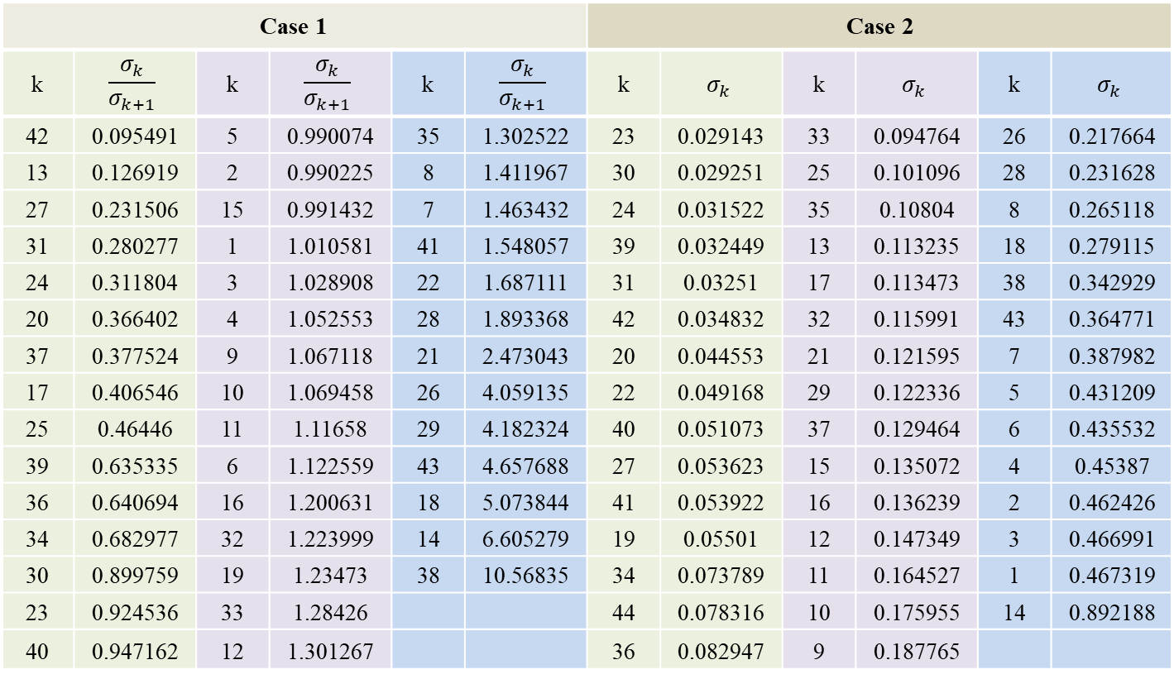
Case 1 |  |  |  |  |  | Case 2
k | $$\frac{σ_{k}}{σ_{k+1}}$$ | k | $$\frac{σ_{k}}{σ_{k+1}}$$ | k | $$\frac{σ_{k}}{σ_{k+1}}$$ | k | $$σ_{k}$$ | k | $$σ_{k}$$ | k | $$σ_{k}$$
42 | 0.095491 | 5 | 0.990074 | 35 | 1.302522 | 23 | 0.029143 | 33 | 0.094764 | 26 | 0.217664
13 | 0.126919 | 2 | 0.990225 | 8 | 1.411967 | 30 | 0.029251 | 25 | 0.101096 | 28 | 0.231628
27 | 0.231506 | 15 | 0.991432 | 7 | 1.463432 | 24 | 0.031522 | 35 | 0.10804 | 8 | 0.265118
31 | 0.280277 | 1 | 1.010581 | 41 | 1.548057 | 39 | 0.032449 | 13 | 0.113235 | 18 | 0.279115
24 | 0.311804 | 3 | 1.028908 | 22 | 1.687111 | 31 | 0.03251 | 17 | 0.113473 | 38 | 0.342929
20 | 0.366402 | 4 | 1.052553 | 28 | 1.893368 | 42 | 0.034832 | 32 | 0.115991 | 43 | 0.364771
37 | 0.377524 | 9 | 1.067118 | 21 | 2.473043 | 20 | 0.044553 | 21 | 0.121595 | 7 | 0.387982
17 | 0.406546 | 10 | 1.069458 | 26 | 4.059135 | 22 | 0.049168 | 29 | 0.122336 | 5 | 0.431209
25 | 0.46446 | 11 | 1.11658 | 29 | 4.182324 | 40 | 0.051073 | 37 | 0.129464 | 6 | 0.435532
39 | 0.635335 | 6 | 1.122559 | 43 | 4.657688 | 27 | 0.053623 | 15 | 0.135072 | 4 | 0.45387
36 | 0.640694 | 16 | 1.200631 | 18 | 5.073844 | 41 | 0.053922 | 16 | 0.136239 | 2 | 0.462426
34 | 0.682977 | 32 | 1.223999 | 14 | 6.605279 | 19 | 0.05501 | 12 | 0.147349 | 3 | 0.466991
30 | 0.899759 | 19 | 1.23473 | 38 | 10.56835 | 34 | 0.073789 | 11 | 0.164527 | 1 | 0.467319
23 | 0.924536 | 33 | 1.28426 |  |  | 44 | 0.078316 | 10 | 0.175955 | 14 | 0.892188
40 | 0.947162 | 12 | 1.301267 |  |  | 36 | 0.082947 | 9 | 0.187765

Slide 17



In Case 1, The best choice is $P_{42}\left(x\right)$
In Case 2, The best choice is $P_{23}\left(x\right)$
f(x) = 9.3634E-01 + 2.7379E+00 * x - 7.7185E+00 * x^2 + 1.9542E+01 * x^3 - 2.3862E+01 * x^4 + 1.4297E+01 * x^5 - 4.4234E+00 * x^6 + 6.5978E-01 * x^7 - 3.0069E-02 * x^8 - 2.6079E-04 * x^9 - 5.8379E-04 * x^10 + 4.8493E-05 * x^11 + 3.5811E-06 * x^12 + 9.9878E-07 * x^13 - 6.9396E-08 * x^14 - 2.6022E-08 * x^15 + 1.2430E-09 * x^16 + 2.4504E-11 * x^17 + 3.7801E-12 * x^18 + 2.1140E-12 * x^19 + 7.0036E-14 * x^20 - 3.4374E-14 * x^21 + 2.6726E-15 * x^22 - 6.0649E-16 * x^23 + 5.2213E-17 * x^24 - 2.1310E-18 * x^25 - 8.5129E-19 * x^26 + 1.3883E-19 * x^27 - 2.6414E-21 * x^28 + 5.8407E-22 * x^29 + 7.1923E-24 * x^30 - 1.3795E-23 * x^31 + 3.0054E-26 * x^32 + 7.8767E-26 * x^33 + 7.1766E-27 * x^34 - 2.5583E-27 * x^35 - 7.5589E-29 * x^36 + 2.2149E-29 * x^37 + 4.0908E-30 * x^38 - 3.0846E-31 * x^39 - 3.0021E-32 * x^40 + 2.1188E-33 * x^41
f(x) = 8.9555E-01 + 3.7718E+00 * x - 1.2220E+01 * x^2 + 2.7663E+01 * x^3 - 3.1421E+01 * x^4 + 1.8109E+01 * x^5 - 5.3070E+00 * x^6 + 6.0390E-01 * x^7 + 5.9007E-02 * x^8 - 2.1808E-02 * x^9 + 1.1722E-03 * x^10 + 1.3100E-04 * x^11 - 7.6800E-06 * x^12 - 8.5752E-07 * x^13 + 1.0231E-07 * x^14 - 1.6236E-08 * x^15 - 1.1984E-09 * x^16 + 3.6072E-10 * x^17 + 4.1009E-11 * x^18 - 6.4732E-12 * x^19 - 5.6029E-13 * x^20 + 1.0455E-13 * x^21 - 3.7802E-15 * x^22

Slide 18
自訂

Slide 19
 | X | Y |  | X | Y |  | X | Y
1 | 0 | 1 | 16 | -0.88 | -0.2 | 31 | 0.7 | 1.2
2 | 0 | 0.9 | 17 | -0.8 | -0.3 | 32 | 0.9 | 1.1
3 | -0.1 | 1.1 | 18 | -0.7 | -0.4 | 33 | 1 | 1
4 | -0.2 | 1.15 | 19 | -0.6 | -0.5 | 34 | 1.1 | 0.8
5 | -0.3 | 1.2 | 20 | -0.5 | -0.6 | 35 | 1.12 | 0.5
6 | -0.4 | 1.21 | 21 | -0.4 | -0.69 | 36 | 1.1 | 0.3
7 | -0.5 | 1.22 | 22 | -0.2 | -0.81 | 37 | 1 | 0
8 | -0.6 | 1.21 | 23 | -0.1 | -0.9 | 38 | 0.88 | -0.2
9 | -0.7 | 1.2 | 24 | 0 | -1 | 39 | 0.8 | -0.3
10 | -0.9 | 1.1 | 25 | 0.1 | 1.1 | 40 | 0.7 | -0.4
11 | -1 | 1 | 26 | 0.2 | 1.15 | 41 | 0.6 | -0.5
12 | -1.1 | 0.8 | 27 | 0.3 | 1.2 | 42 | 0.5 | -0.6
13 | -1.12 | 0.5 | 28 | 0.4 | 1.21 | 43 | 0.4 | -0.69
14 | -1.1 | 0.3 | 29 | 0.5 | 1.22 | 44 | 0.2 | -0.81
15 | -1 | 0 | 30 | 0.6 | 1.21 | 45 | 0.1 | -0.9

Slide 20
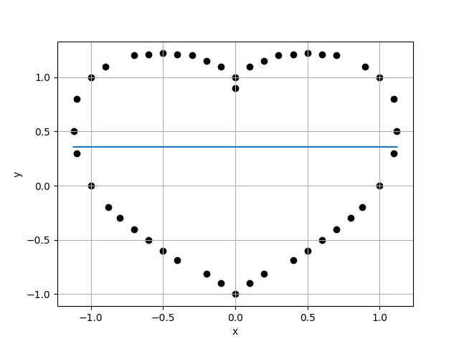
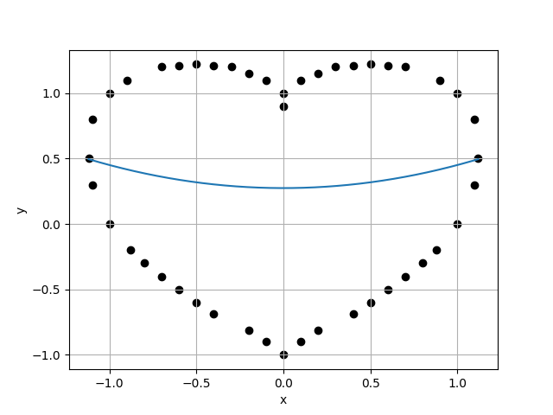
Case 1 :
Case 2 :
f(x) = 3.5733E-01
f(x) = 3.5733E-01 + 3.4387E-17 * x
8.0885E-01
8.1820E-01
9.8857E-01
9.9269E-01
Case 3 :
f(x) = 2.7428E-01 + 3.8385E-17 * x + 1.7615E-01 * x^2
Case 4 :
f(x) = 2.7428E-01 + 6.5831E-16 * x + 1.7615E-01 * x^2 + -7.2317E-16 * x^3
8.2423E-01
8.3422E-01
9.8802E-01
9.8882E-01

Slide 21
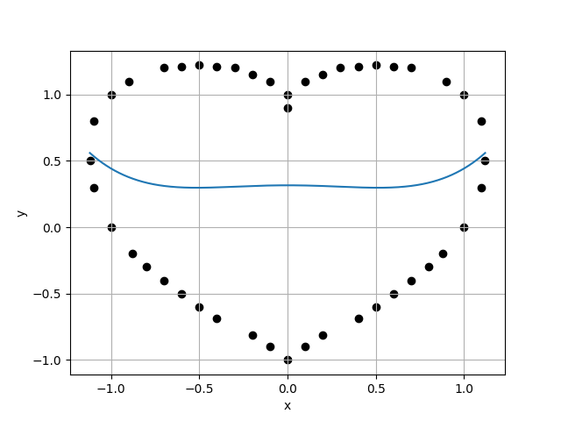
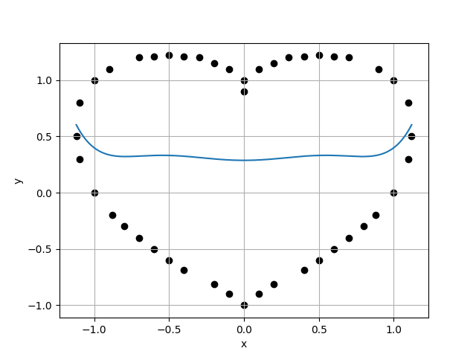
Case 5 :
Case 6 :
f(x) = 3.1567E-01 + 4.8899E-16 * x + -1.4008E-01 * x^2 + -5.5060E-16 * x^3 + 2.6649E-01 * x^4
f(x) = 3.1567E-01 + 3.8693E-15 * x + -1.4008E-01 * x^2 + -1.2292E-14 * x^3 + 2.6649E-01 * x^4 + 7.7559E-15 * x^5
8.4365E-01
8.5440E-01
9.8742E-01
9.8772E-01
Case 7 :
f(x) = 2.8707E-01 + 3.5654E-15 * x + 3.5471E-01 * x^2 + -1.0642E-14 * x^3 + -8.7744E-01 * x^4 + 6.5116E-15 * x^5 + 6.3402E-01 * x^6
Case 8 :
f(x) = 2.8707E-01 + -1.1195E-14 * x + 3.5471E-01 * x^2 + 8.7276E-14 * x^3 + -8.7744E-01 * x^4 + -1.5455E-13 * x^5 + 6.3402E-01 * x^6 + 7.4787E-14 * x^7
8.6502E-01
8.7664E-01
9.8675E-01
9.9404E-01

Slide 22
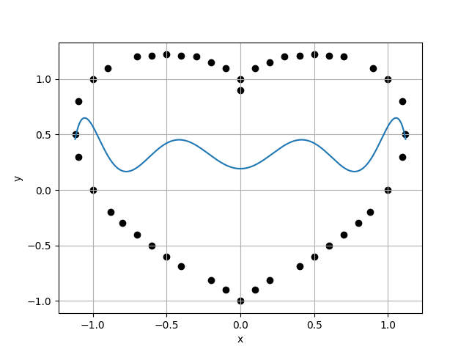

Case 9 :
Case 10 :
f(x) = 1.9164E-01 + -9.7532E-13 * x + 3.5211E+00 * x^2 + 6.2384E-12 * x^3 + -1.4746E+01 * x^4 + -1.0011E-11 * x^5 + 1.9281E+01 * x^6 + 4.5711E-12 * x^7 + -7.6761E+00 * x^8
f(x) = 1.9164E-01 + -5.8532E-12 * x + 3.5211E+00 * x^2 + 6.1083E-11 * x^3 + -1.4746E+01 * x^4 + -1.7709E-10 * x^5 + 1.9281E+01 * x^6 + 1.9050E-10 * x^7 + -7.6761E+00 * x^8 + -6.8131E-11 * x^9
8.8189E-01
8.9440E-01
9.8601E-01
9.8586E-01
Case 11 :
f(x) = 1.7475E-01 + -9.3200E-12 * x + 4.4115E+00 * x^2 + 9.5922E-11 * x^3 + -2.0910E+01 * x^4 + -2.7583E-10 * x^5 + 3.3884E+01 * x^6 + 2.9522E-10 * x^7 + -2.1612E+01 * x^8 + -1.0522E-10 * x^9 + 4.6089E+00 * x^10
Case 12 :
f(x) = 1.7475E-01 + -4.5282E-11 * x + 4.4115E+00 * x^2 + 7.1401E-10 * x^3 + -2.0910E+01 * x^4 + -3.2122E-09 * x^5 + 3.3884E+01 * x^6 + 5.9255E-09 * x^7 + -2.1612E+01 * x^8 + -4.7883E-09 * x^9 + 4.6089E+00 * x^10 + 1.4064E-09 * x^11
9.0723E-01
9.2087E-01
9.8518E-01
9.8475E-01

Slide 23


Case 13 :
Case 14 :
f(x) = 1.7962E-01 + 4.7056E-12 * x + 4.0474E+00 * x^2 + -1.0908E-10 * x^3 + -1.7288E+01 * x^4 + 5.9502E-10 * x^5 + 2.0912E+01 * x^6 + -1.2373E-09 * x^7 + -7.9525E-01 * x^8 + 1.0851E-09 * x^9 + -1.0692E+01 * x^10 + -3.3817E-10 * x^11 + 4.1959E+00 * x^12
f(x) = 1.7962E-01 + -4.8171E-12 * x + 4.0474E+00 * x^2 + 1.2506E-10 * x^3 + -1.7288E+01 * x^4 + -9.9289E-10 * x^5 + 2.0912E+01 * x^6 + 3.3223E-09 * x^7 + -7.9525E-01 * x^8 + -5.2277E-09 * x^9 + -1.0692E+01 * x^10 + 3.8321E-09 * x^11 + 4.1959E+00 * x^12 + -1.0546E-09 * x^13
9.3513E-01
9.5009E-01
9.8425E-01
9.8575E-01
Case 15 :
f(x) = 1.3042E-01 + -7.5103E-09 * x + 8.7003E+00 * x^2 + 1.6421E-07 * x^3 + -7.7866E+01 * x^4 + -1.0260E-06 * x^5 + 3.1469E+02 * x^6 + 2.7633E-06 * x^7 + -6.7842E+02 * x^8 + -3.6326E-06 * x^9 + 7.9095E+02 * x^10 + 2.2989E-06 * x^11 + -4.6567E+02 * x^12 + -5.6076E-07 * x^13 + 1.0811E+02 * x^14
Case 16 :
f(x) = 1.3042E-01 + 1.1980E-08 * x + 8.7003E+00 * x^2 + -4.7387E-07 * x^3 + -7.7866E+01 * x^4 + 4.6406E-06 * x^5 + 3.1469E+02 * x^6 + -1.9037E-05 * x^7 + -6.7842E+02 * x^8 + 3.9049E-05 * x^9 + 7.9095E+02 * x^10 + -4.2231E-05 * x^11 + -4.6567E+02 * x^12 + 2.3026E-05 * x^13 + 1.0811E+02 * x^14 + -4.9882E-06 * x^15
9.6383E-01
9.8031E-01
9.8319E-01
9.8983E-01

Slide 24




Case 17 :
Case 18 :
f(x) = 3.1977E-02 + 9.6791E-07 * x + 2.1041E+01 * x^2 + -3.1730E-05 * x^3 + -2.9827E+02 * x^4 + 2.8124E-04 * x^5 + 1.7834E+03 * x^6 + -1.0787E-03 * x^7 + -5.4231E+03 * x^8 + 2.1048E-03 * x^9 + 9.0296E+03 * x^10 + -2.1880E-03 * x^11 + -8.3276E+03 * x^12 + 1.1548E-03 * x^13 + 3.9908E+03 * x^14 + -2.4336E-04 * x^15 + -7.7537E+02 * x^16
f(x) = 3.1977E-02 + 1.4601E-05 * x + 2.1041E+01 * x^2 + -6.2435E-04 * x^3 + -2.9827E+02 * x^4 + 7.3220E-03 * x^5 + 1.7834E+03 * x^6 + -3.8125E-02 * x^7 + -5.4231E+03 * x^8 + 1.0463E-01 * x^9 + 9.0296E+03 * x^10 + -1.6191E-01 * x^11 + -8.3277E+03 * x^12 + 1.4188E-01 * x^13 + 3.9908E+03 * x^14 + -6.5625E-02 * x^15 + -7.7537E+02 * x^16 + 1.2441E-02 * x^17
9.9038E-01
1.0086E+00
9.8198E-01
1.0089E+00
Case 19 :
Case 20 :
f(x) = 2.0024E-01 + -1.7540E-03 * x + -7.8088E+00 * x^2 + 9.2851E-02 * x^3 + 4.1563E+02 * x^4 + -1.3913E+00 * x^5 + -4.7329E+03 * x^6 + 9.4700E+00 * x^7 + 2.3765E+04 * x^8 + -3.4910E+01 * x^9 + -6.3383E+04 * x^10 + 7.5427E+01 * x^11 + 9.5987E+04 * x^12 + -9.8114E+01 * x^13 + -8.2715E+04 * x^14 + 7.5473E+01 * x^15 + 3.7749E+04 * x^16 + -3.1579E+01 * x^17 + -7.0781E+03 * x^18 + 5.5333E+00 * x^19
f(x) = 2.0025E-01 + -2.0121E-04 * x + -7.8104E+00 * x^2 + 8.5158E-03 * x^3 + 4.1567E+02 * x^4 + -9.9167E-02 * x^5 + -4.7332E+03 * x^6 + 5.1365E-01 * x^7 + 2.3766E+04 * x^8 + -1.4040E+00 * x^9 + -6.3386E+04 * x^10 + 2.1661E+00 * x^11 + 9.5992E+04 * x^12 + -1.8937E+00 * x^13 + -8.2719E+04 * x^14 + 8.7423E-01 * x^15 + 3.7751E+04 * x^16 + -1.6548E-01 * x^17 + -7.0784E+03 * x^18
9.9967E-01
1.0195E+00
9.8058E-01
9.7996E-01

Slide 25




Case 21 :
Case 22 :
f(x) = 1.8688E-01 + -6.0911E-04 * x + -4.6763E+00 * x^2 + 3.2339E-02 * x^3 + 3.1322E+02 * x^4 + -4.8564E-01 * x^5 + -3.5148E+03 * x^6 + 3.3110E+00 * x^7 + 1.6590E+04 * x^8 + -1.2221E+01 * x^9 + -3.9463E+04 * x^10 + 2.6431E+01 * x^11 + 4.7975E+04 * x^12 + -3.4407E+01 * x^13 + -2.3648E+04 * x^14 + 2.6483E+01 * x^15 + -5.7665E+03 * x^16 + -1.1087E+01 * x^17 + 1.0521E+04 * x^18 + 1.9434E+00 * x^19 + -3.0010E+03 * x^20
f(x) = 1.8699E-01 + -3.5398E-03 * x + -4.6997E+00 * x^2 + 2.3910E-01 * x^3 + 3.1397E+02 * x^4 + -4.7296E+00 * x^5 + -3.5236E+03 * x^6 + 4.2777E+01 * x^7 + 1.6641E+04 * x^8 + -2.1163E+02 * x^9 + -3.9632E+04 * x^10 + 6.2523E+02 * x^11 + 4.8310E+04 * x^12 + -1.1490E+03 * x^13 + -2.4059E+04 * x^14 + 1.3226E+03 * x^15 + -5.4655E+03 * x^16 + -9.2550E+02 * x^17 + 1.0399E+04 * x^18 + 3.5944E+02 * x^19 + -2.9804E+03 * x^20 + -5.9339E+01 * x^21
1.0403E+00
1.0627E+00
9.7894E-01
9.5398E-01
Case 23 :
f(x) = 9.2990E-02 + 1.4767E-01 * x + 2.0845E+01 * x^2 + -9.7793E+00 * x^3 + -6.5346E+02 * x^4 + 1.9015E+02 * x^5 + 1.0106E+04 * x^6 + -1.6973E+03 * x^7 + -8.0843E+04 * x^8 + 8.3121E+03 * x^9 + 3.6598E+05 * x^10 + -2.4363E+04 * x^11 + -1.0017E+06 * x^12 + 4.4493E+04 * x^13 + 1.7167E+06 * x^14 + -5.0955E+04 * x^15 + -1.8519E+06 * x^16 + 3.5513E+04 * x^17 + 1.2206E+06 * x^18 + -1.3746E+04 * x^19 + -4.4873E+05 * x^20 + 2.2632E+03 * x^21 + 7.0469E+04 * x^22
Case 24 :
f(x) = 7.9873E-02 + 1.9166E-01 * x + 2.4684E+01 * x^2 + -1.2686E+01 * x^3 + -8.0716E+02 * x^4 + 2.4641E+02 * x^5 + 1.2382E+04 * x^6 + -2.1960E+03 * x^7 + -9.7842E+04 * x^8 + 1.0730E+04 * x^9 + 4.3946E+05 * x^10 + -3.1344E+04 * x^11 + -1.1983E+06 * x^12 + 5.6958E+04 * x^13 + 2.0517E+06 * x^14 + -6.4721E+04 * x^15 + -2.2159E+06 * x^16 + 4.4497E+04 * x^17 + 1.4640E+06 * x^18 + -1.6744E+04 * x^19 + -5.3988E+05 * x^20 + 2.5165E+03 * x^21 + 8.5088E+04 * x^22 + 6.8771E+01 * x^23
1.1140E+00
1.1467E+00
9.7142E-01
1.0339E+00

Slide 26




Case 25 :
Case 26 :
f(x) = 2.8323E-01 + -5.3260E-04 * x + -3.3028E+01 * x^2 + 2.1903E+00 * x^3 + 1.4306E+03 * x^4 + -9.7840E+01 * x^5 + -1.9434E+04 * x^6 + 1.4860E+03 * x^7 + 1.2805E+05 * x^8 + -1.1171E+04 * x^9 + -4.7303E+05 * x^10 + 4.8266E+04 * x^11 + 1.0187E+06 * x^12 + -1.2875E+05 * x^13 + -1.1964E+06 * x^14 + 2.1871E+05 * x^15 + 4.4556E+05 * x^16 + -2.3671E+05 * x^17 + 6.5496E+05 * x^18 + 1.5775E+05 * x^19 + -9.6830E+05 * x^20 + -5.8916E+04 * x^21 + 5.0738E+05 * x^22 + 9.4231E+03 * x^23 + -9.8861E+04 * x^24
f(x) = 2.8248E-01 + -2.1350E+00 * x + -3.2637E+01 * x^2 + 1.5932E+02 * x^3 + 1.4094E+03 * x^4 + -3.5058E+03 * x^5 + -1.9038E+04 * x^6 + 3.5051E+04 * x^7 + 1.2442E+05 * x^8 + -1.8968E+05 * x^9 + -4.5405E+05 * x^10 + 5.9901E+05 * x^11 + 9.5707E+05 * x^12 + -1.1089E+06 * x^13 + -1.0670E+06 * x^14 + 1.0634E+06 * x^15 + 2.6653E+05 * x^16 + -1.0304E+05 * x^17 + 8.1697E+05 * x^18 + -9.3414E+05 * x^19 + -1.0605E+06 * x^20 + 1.0388E+06 * x^21 + 5.3731E+05 * x^22 + -4.8468E+05 * x^23 + -1.0309E+05 * x^24 + 8.7467E+04 * x^25
1.1091E+00
1.1432E+00
9.7015E-01
9.6775E-01
Case 27 :
f(x) = 2.5794E-01 + -2.5104E+00 * x + -2.3836E+01 * x^2 + 1.8331E+02 * x^3 + 9.9459E+02 * x^4 + -3.9417E+03 * x^5 + -1.1836E+04 * x^6 + 3.8462E+04 * x^7 + 6.1790E+04 * x^8 + -2.0217E+05 * x^9 + -1.4216E+05 * x^10 + 6.1285E+05 * x^11 + 1.1028E+04 * x^12 + -1.0539E+06 * x^13 + 7.0133E+05 * x^14 + 8.0987E+05 * x^15 + -1.6557E+06 * x^16 + 3.8377E+05 * x^17 + 1.6944E+06 * x^18 + -1.4678E+06 * x^19 + -6.0795E+05 * x^20 + 1.3849E+06 * x^21 + -3.0054E+05 * x^22 + -6.0845E+05 * x^23 + 3.2979E+05 * x^24 + 1.0633E+05 * x^25 + -8.1125E+04 * x^26
Case 28 :
f(x) = 2.7751E-01 + -2.5792E-01 * x + -3.0625E+01 * x^2 + 2.0193E+01 * x^3 + 1.3054E+03 * x^4 + -4.7395E+02 * x^5 + -1.7080E+04 * x^6 + 5.1335E+03 * x^7 + 1.0624E+05 * x^8 + -3.0700E+04 * x^9 + -3.5872E+05 * x^10 + 1.1020E+05 * x^11 + 6.5688E+05 * x^12 + -2.4324E+05 * x^13 + -4.9534E+05 * x^14 + 3.1383E+05 * x^15 + -3.4114E+05 * x^16 + -1.6813E+05 * x^17 + 1.0266E+06 * x^18 + -1.3000E+05 * x^19 + -7.7968E+05 * x^20 + 3.0361E+05 * x^21 + 1.4559E+05 * x^22 + -2.3554E+05 * x^23 + 9.1588E+04 * x^24 + 8.8971E+04 * x^25 + -3.6226E+04 * x^26 + -1.3672E+04 * x^27
1.1813E+00
1.2049E+00
9.8045E-01
9.7567E-01

Slide 27




Case 29 :
Case 30 :
f(x) = 3.4170E-01 + -5.5937E-01 * x + -5.0203E+01 * x^2 + 3.9541E+01 * x^3 + 2.1147E+03 * x^4 + -8.2205E+02 * x^5 + -2.9340E+04 * x^6 + 7.7244E+03 * x^7 + 1.9828E+05 * x^8 + -3.8441E+04 * x^9 + -7.4495E+05 * x^10 + 1.0457E+05 * x^11 + 1.5944E+06 * x^12 + -1.2868E+05 * x^13 + -1.7378E+06 * x^14 + -7.4910E+04 * x^15 + 2.7395E+05 * x^16 + 5.3845E+05 * x^17 + 1.4011E+06 * x^18 + -9.1053E+05 * x^19 + -1.0262E+06 * x^20 + 8.3340E+05 * x^21 + -6.7643E+05 * x^22 + -4.4452E+05 * x^23 + 1.2919E+06 * x^24 + 1.2972E+05 * x^25 + -6.6957E+05 * x^26 + -1.5987E+04 * x^27 + 1.2258E+05 * x^28
f(x) = 1.5346E-01 + 2.0380E+00 * x + 8.0014E+00 * x^2 + -1.1311E+02 * x^3 + -3.1653E+02 * x^4 + 1.4679E+03 * x^5 + 7.8907E+03 * x^6 + -2.9598E+03 * x^7 + -8.4636E+04 * x^8 + -6.0848E+04 * x^9 + 4.5998E+05 * x^10 + 5.0701E+05 * x^11 + -1.3888E+06 * x^12 + -1.7933E+06 * x^13 + 2.3292E+06 * x^14 + 3.3843E+06 * x^15 + -1.8048E+06 * x^16 + -3.2805E+06 * x^17 + -2.2048E+05 * x^18 + 9.5288E+05 * x^19 + 1.2215E+06 * x^20 + 7.5226E+05 * x^21 + -6.0171E+04 * x^22 + -5.0653E+04 * x^23 + -1.0601E+06 * x^24 + -9.7840E+05 * x^25 + 7.7631E+05 * x^26 + 7.3721E+05 * x^27 + -1.7546E+05 * x^28 + -1.6827E+05 * x^29
1.2349E+00
1.3210E+00
9.3479E-01
9.7338E-01
Case 31 :
f(x) = 6.4646E-01 + -1.1113E+00 * x + -1.4477E+02 * x^2 + 9.7222E+01 * x^3 + 6.0218E+03 * x^4 + -2.5148E+03 * x^5 + -8.7560E+04 * x^6 + 2.9460E+04 * x^7 + 6.1988E+05 * x^8 + -1.8771E+05 * x^9 + -2.3997E+06 * x^10 + 7.0781E+05 * x^11 + 5.1230E+06 * x^12 + -1.6172E+06 * x^13 + -5.0834E+06 * x^14 + 2.1286E+06 * x^15 + -6.3498E+05 * x^16 + -1.1839E+06 * x^17 + 5.7914E+06 * x^18 + -6.3156E+05 * x^19 + -2.4702E+06 * x^20 + 1.3148E+06 * x^21 + -3.4397E+06 * x^22 + -4.7064E+05 * x^23 + 2.5042E+06 * x^24 + -3.1775E+05 * x^25 + 1.4135E+06 * x^26 + 2.9845E+05 * x^27 + -1.8209E+06 * x^28 + -6.7979E+04 * x^29 + 4.7864E+05 * x^30
Case 32 :
f(x) = 2.6200E-01 + -1.4253E-01 * x + -2.5549E+01 * x^2 + 3.3639E+00 * x^3 + 1.0732E+03 * x^4 + 1.3660E+02 * x^5 + -1.3012E+04 * x^6 + -4.0898E+03 * x^7 + 6.9476E+04 * x^8 + 4.2245E+04 * x^9 + -1.6458E+05 * x^10 + -2.2541E+05 * x^11 + 2.7090E+04 * x^12 + 6.8905E+05 * x^13 + 7.5001E+05 * x^14 + -1.1954E+06 * x^15 + -1.6820E+06 * x^16 + 9.3211E+05 * x^17 + 1.3593E+06 * x^18 + 3.6970E+05 * x^19 + 9.6765E+04 * x^20 + -1.3264E+06 * x^21 + -6.0986E+05 * x^22 + 6.4031E+05 * x^23 + -2.6996E+05 * x^24 + 6.8257E+05 * x^25 + 8.2222E+05 * x^26 + -1.0024E+06 * x^27 + -4.8028E+05 * x^28 + 4.8289E+05 * x^29 + 9.3803E+04 * x^30 + -8.5375E+04 * x^31
1.3572E+00
1.3793E+00
9.8396E-01
9.7046E-01

Slide 28




Case 33 :
Case 34 :
f(x) = 4.1323E-01 + 5.7559E-01 * x + -7.1745E+01 * x^2 + -4.0851E+01 * x^3 + 2.9708E+03 * x^4 + 8.5378E+02 * x^5 + -4.1361E+04 * x^6 + -8.0949E+03 * x^7 + 2.7798E+05 * x^8 + 4.1113E+04 * x^9 + -1.0181E+06 * x^10 + -1.1860E+05 * x^11 + 2.0580E+06 * x^12 + 1.8675E+05 * x^13 + -2.0034E+06 * x^14 + -1.1143E+05 * x^15 + 1.9793E+05 * x^16 + -9.8922E+04 * x^17 + 9.7907E+05 * x^18 + 1.8657E+05 * x^19 + 3.9885E+04 * x^20 + -4.5278E+04 * x^21 + -6.5025E+05 * x^22 + -6.5118E+04 * x^23 + -1.7494E+05 * x^24 + -2.3501E+03 * x^25 + 1.1034E+04 * x^26 + 7.3898E+04 * x^27 + 9.4386E+05 * x^28 + -4.9707E+04 * x^29 + -8.3518E+05 * x^30 + 1.0366E+04 * x^31 + 2.1258E+05 * x^32
f(x) = 1.8642E-01 + -1.0346E+00 * x + -3.4449E+00 * x^2 + 8.4432E+01 * x^3 + 2.0045E+02 * x^4 + -2.0491E+03 * x^5 + -5.8614E+02 * x^6 + 2.2495E+04 * x^7 + -1.6167E+04 * x^8 + -1.3242E+05 * x^9 + 1.5245E+05 * x^10 + 4.4709E+05 * x^11 + -5.9817E+05 * x^12 + -8.5638E+05 * x^13 + 1.2707E+06 * x^14 + 7.8572E+05 * x^15 + -1.5302E+06 * x^16 + 3.5296E+04 * x^17 + 1.0030E+06 * x^18 + -6.6642E+05 * x^19 + -3.5697E+05 * x^20 + 3.5677E+05 * x^21 + 2.0861E+05 * x^22 + -1.5063E+04 * x^23 + -2.8958E+05 * x^24 + 2.8029E+05 * x^25 + 3.2529E+05 * x^26 + -3.6175E+05 * x^27 + -3.0508E+05 * x^28 + 3.3209E+04 * x^29 + 1.7910E+05 * x^30 + 1.1341E+05 * x^31 + -4.2654E+04 * x^32 + -4.0283E+04 * x^33
1.4213E+00
1.5174E+00
9.3664E-01
9.7114E-01
Case 35 :
f(x) = 4.7471E-01 + -4.1395E-01 * x + -8.9425E+01 * x^2 + 5.6192E+01 * x^3 + 3.5899E+03 * x^4 + -1.9159E+03 * x^5 + -4.7806E+04 * x^6 + 2.6922E+04 * x^7 + 2.9420E+05 * x^8 + -1.9500E+05 * x^9 + -8.9457E+05 * x^10 + 8.0484E+05 * x^11 + 1.0684E+06 * x^12 + -1.9483E+06 * x^13 + 9.2640E+05 * x^14 + 2.6132E+06 * x^15 + -4.0669E+06 * x^16 + -1.3050E+06 * x^17 + 3.8815E+06 * x^18 + -1.2042E+06 * x^19 + -1.1260E+06 * x^20 + 2.1946E+06 * x^21 + 1.4060E+06 * x^22 + -1.3467E+06 * x^23 + -2.4852E+06 * x^24 + 7.1597E+05 * x^25 + -5.8013E+04 * x^26 + -7.0286E+05 * x^27 + 1.7287E+06 * x^28 + 4.6237E+05 * x^29 + -7.5381E+04 * x^30 + -1.1709E+05 * x^31 + -8.7143E+05 * x^32 + 3.1583E+03 * x^33 + 3.1667E+05 * x^34
Case 36 :
f(x) = 4.5184E-01 + 1.0764E-01 * x + -8.3941E+01 * x^2 + -2.5001E+00 * x^3 + 3.4807E+03 * x^4 + -7.2129E+01 * x^5 + -4.9074E+04 * x^6 + 1.7561E+03 * x^7 + 3.3534E+05 * x^8 + -1.2430E+04 * x^9 + -1.2559E+06 * x^10 + 3.1206E+04 * x^11 + 2.6302E+06 * x^12 + 2.8254E+04 * x^13 + -2.7594E+06 * x^14 + -3.2238E+05 * x^15 + 5.1044E+05 * x^16 + 6.9048E+05 * x^17 + 1.6402E+06 * x^18 + -5.6905E+05 * x^19 + -1.2632E+06 * x^20 + -2.7460E+04 * x^21 + 2.2246E+05 * x^22 + 3.1081E+05 * x^23 + 5.6413E+04 * x^24 + -1.4354E+05 * x^25 + -6.0329E+05 * x^26 + 6.7006E+03 * x^27 + 7.7978E+05 * x^28 + 1.2053E+05 * x^29 + -3.7571E+04 * x^30 + -2.6430E+05 * x^31 + -3.3160E+05 * x^32 + 2.0017E+05 * x^33 + 1.2188E+05 * x^34 + -5.0672E+04 * x^35
1.5625E+00
1.6428E+00
9.5111E-01
6.2959E-01

Slide 29




Case 37 :
Case 38 :
f(x) = -6.7346E-01 + -4.0998E+00 * x + 2.5142E+02 * x^2 + 4.2093E+02 * x^3 + -9.7994E+03 * x^4 + -1.2183E+04 * x^5 + 1.3827E+05 * x^6 + 1.5261E+05 * x^7 + -9.3029E+05 * x^8 + -1.0008E+06 * x^9 + 3.2975E+06 * x^10 + 3.7260E+06 * x^11 + -6.1691E+06 * x^12 + -7.9205E+06 * x^13 + 5.6060E+06 * x^14 + 8.5216E+06 * x^15 + -3.7358E+06 * x^16 + -1.3182E+06 * x^17 + 1.0284E+07 * x^18 + -6.5034E+06 * x^19 + -1.9386E+07 * x^20 + 5.1315E+06 * x^21 + 1.3538E+07 * x^22 + 4.6862E+05 * x^23 + -1.9302E+06 * x^24 + -1.2983E+06 * x^25 + 2.0971E+06 * x^26 + -3.0005E+05 * x^27 + -4.3425E+06 * x^28 + 6.3554E+05 * x^29 + 1.0786E+06 * x^30 + -7.1351E+05 * x^31 + 9.2538E+04 * x^32 + 6.2023E+05 * x^33 + 7.6491E+05 * x^34 + -1.8955E+05 * x^35 + -3.9449E+05 * x^36
f(x) = 3.9433E-01 + -4.4027E-01 * x + -6.6610E+01 * x^2 + 7.1898E+01 * x^3 + 2.7819E+03 * x^4 + -2.5055E+03 * x^5 + -3.8938E+04 * x^6 + 3.3734E+04 * x^7 + 2.6420E+05 * x^8 + -2.2485E+05 * x^9 + -9.8661E+05 * x^10 + 8.2471E+05 * x^11 + 2.0743E+06 * x^12 + -1.7334E+06 * x^13 + -2.1911E+06 * x^14 + 2.1262E+06 * x^15 + 2.6150E+05 * x^16 + -1.7137E+06 * x^17 + 2.0592E+06 * x^18 + 1.3148E+06 * x^19 + -2.4072E+06 * x^20 + -6.0764E+05 * x^21 + 1.1699E+06 * x^22 + -6.0230E+05 * x^23 + 1.7939E+04 * x^24 + 1.8656E+05 * x^25 + -2.0525E+05 * x^26 + 1.0827E+06 * x^27 + -5.7547E+05 * x^28 + -3.0423E+05 * x^29 + 9.1493E+05 * x^30 + -5.8547E+05 * x^31 + -2.9081E+05 * x^32 + -2.4647E+05 * x^33 + -1.4437E+05 * x^34 + 6.8848E+05 * x^35 + 7.5083E+04 * x^36 + -2.3664E+05 * x^37
2.6093E+00
1.8636E+00
1.4001E+00
8.4434E-01
Case 39 :
f(x) = 5.6913E-01 + 6.0009E+00 * x + -1.1911E+02 * x^2 + -7.8775E+02 * x^3 + 4.9206E+03 * x^4 + 2.5680E+04 * x^5 + -7.0725E+04 * x^6 + -3.4099E+05 * x^7 + 4.9618E+05 * x^8 + 2.3011E+06 * x^9 + -1.9148E+06 * x^10 + -8.6843E+06 * x^11 + 4.1285E+06 * x^12 + 1.8752E+07 * x^13 + -4.3403E+06 * x^14 + -2.1842E+07 * x^15 + 2.0791E+05 * x^16 + 1.0181E+07 * x^17 + 4.0332E+06 * x^18 + 2.0180E+06 * x^19 + -2.7294E+06 * x^20 + -7.3228E+05 * x^21 + -7.6503E+05 * x^22 + -3.4352E+06 * x^23 + 1.1584E+06 * x^24 + 2.8657E+06 * x^25 + -7.8306E+05 * x^26 + -2.3665E+06 * x^27 + 1.4849E+06 * x^28 + 3.0968E+05 * x^29 + -8.8822E+05 * x^30 + 1.2287E+06 * x^31 + -6.2317E+05 * x^32 + 1.4146E+06 * x^33 + 9.4407E+05 * x^34 + -2.5611E+06 * x^35 + -4.0654E+05 * x^36 + 8.6604E+05 * x^37 + 6.3381E+04 * x^38
Case 40 :
f(x) = 6.2698E-01 + -7.0891E-01 * x + -1.3526E+02 * x^2 + 6.5203E+01 * x^3 + 5.4777E+03 * x^4 + -1.6809E+03 * x^5 + -7.6594E+04 * x^6 + 1.8008E+04 * x^7 + 5.1542E+05 * x^8 + -9.1305E+04 * x^9 + -1.8747E+06 * x^10 + 1.9440E+05 * x^11 + 3.7392E+06 * x^12 + 9.6956E+04 * x^13 + -3.6437E+06 * x^14 + -1.3247E+06 * x^15 + 7.0917E+05 * x^16 + 2.5332E+06 * x^17 + 1.1000E+06 * x^18 + -1.6652E+06 * x^19 + 6.5810E+04 * x^20 + -4.4381E+05 * x^21 + -6.7730E+05 * x^22 + 8.1150E+05 * x^23 + 3.8165E+05 * x^24 + 1.1925E+05 * x^25 + -7.3100E+05 * x^26 + -3.0311E+05 * x^27 + 3.2821E+05 * x^28 + 1.5579E+05 * x^29 + 9.1485E+04 * x^30 + -1.3099E+05 * x^31 + 4.3961E+05 * x^32 + 2.8589E+03 * x^33 + -3.4869E+05 * x^34 + -4.7385E+04 * x^35 + -1.2790E+05 * x^36 + 1.2876E+05 * x^37 + 1.0391E+05 * x^38 + -5.2573E+04 * x^39
2.2072E+00
2.2566E+00
9.7811E-01
9.1611E-01

Slide 30




Case 41 :
Case 42 :
f(x) = 4.2941E-01 + 1.2360E+00 * x + -7.6610E+01 * x^2 + -1.2043E+02 * x^3 + 3.1445E+03 * x^4 + 3.3225E+03 * x^5 + -4.3243E+04 * x^6 + -3.9432E+04 * x^7 + 2.8493E+05 * x^8 + 2.4068E+05 * x^9 + -1.0164E+06 * x^10 + -8.0427E+05 * x^11 + 2.0085E+06 * x^12 + 1.4089E+06 * x^13 + -2.0463E+06 * x^14 + -8.7081E+05 * x^15 + 8.1180E+05 * x^16 + -8.8569E+05 * x^17 + -8.7619E+04 * x^18 + 1.4373E+06 * x^19 + 2.3014E+05 * x^20 + -3.6413E+04 * x^21 + 1.6327E+05 * x^22 + -5.2392E+05 * x^23 + -2.1977E+05 * x^24 + -1.5383E+05 * x^25 + -3.8097E+05 * x^26 + -1.5825E+03 * x^27 + -1.6278E+04 * x^28 + 3.0461E+05 * x^29 + 4.5278E+05 * x^30 + 1.0405E+05 * x^31 + 4.9375E+04 * x^32 + -1.7098E+05 * x^33 + -1.9717E+05 * x^34 + -9.9488E+04 * x^35 + -4.8527E+04 * x^36 + 1.0647E+05 * x^37 + 5.0273E+04 * x^38 + -1.8864E+04 * x^39 + 2.1693E+03 * x^40
f(x) = 6.0848E-01 + 1.9114E+00 * x + -1.2872E+02 * x^2 + -1.4238E+02 * x^3 + 5.1596E+03 * x^4 + 2.9083E+03 * x^5 + -7.0728E+04 * x^6 + -2.2133E+04 * x^7 + 4.6055E+05 * x^8 + 4.1471E+04 * x^9 + -1.5796E+06 * x^10 + 3.1121E+05 * x^11 + 2.7764E+06 * x^12 + -1.9482E+06 * x^13 + -1.7303E+06 * x^14 + 4.2582E+06 * x^15 + -1.4512E+06 * x^16 + -3.1804E+06 * x^17 + 2.0908E+06 * x^18 + -1.6970E+06 * x^19 + 3.9061E+05 * x^20 + 2.1510E+06 * x^21 + -6.9339E+05 * x^22 + 2.5499E+06 * x^23 + -7.8020E+05 * x^24 + -2.0640E+06 * x^25 + 3.9364E+05 * x^26 + -1.6551E+06 * x^27 + 2.7660E+05 * x^28 + 8.5895E+05 * x^29 + 1.0311E+04 * x^30 + 3.8722E+04 * x^31 + -3.6001E+05 * x^32 + 6.2374E+05 * x^33 + 5.6303E+05 * x^34 + 3.0374E+05 * x^35 + -2.8785E+05 * x^36 + -6.6952E+05 * x^37 + -8.9691E+04 * x^38 + -3.7829E+04 * x^39 + 7.6006E+04 * x^40 + 1.3429E+05 * x^41
2.4633E+00
2.9062E+00
8.4758E-01
8.3514E-01
Case 43 :
f(x) = 3.8921E-01 + -8.1722E-01 * x + -6.4245E+01 * x^2 + 8.4567E+01 * x^3 + 2.6250E+03 * x^4 + -2.4150E+03 * x^5 + -3.5154E+04 * x^6 + 2.9155E+04 * x^7 + 2.2159E+05 * x^8 + -1.7920E+05 * x^9 + -7.3228E+05 * x^10 + 5.9999E+05 * x^11 + 1.2330E+06 * x^12 + -1.0588E+06 * x^13 + -7.3079E+05 * x^14 + 7.2016E+05 * x^15 + -5.5599E+05 * x^16 + 4.3272E+05 * x^17 + 6.7462E+05 * x^18 + -7.8909E+05 * x^19 + 3.1206E+05 * x^20 + 8.9329E+03 * x^21 + -4.1813E+05 * x^22 + 2.3175E+05 * x^23 + -1.8326E+04 * x^24 + 4.2846E+04 * x^25 + 1.6464E+05 * x^26 + 1.1324E+05 * x^27 + -3.1783E+05 * x^28 + -1.1544E+05 * x^29 + 6.4043E+04 * x^30 + -9.0226E+04 * x^31 + 2.2250E+05 * x^32 + 3.3696E+04 * x^33 + -2.4728E+04 * x^34 + 4.5565E+03 * x^35 + -2.3948E+04 * x^36 + 1.4164E+04 * x^37 + -4.2130E+04 * x^38 + 1.9563E+04 * x^39 + -2.0889E+04 * x^40 + -1.5684E+04 * x^41 + 2.5129E+04 * x^42
Case 44 :
f(x) = 4.2987E-01 + -7.3845E-01 * x + -7.6541E+01 * x^2 + 7.0546E+01 * x^3 + 3.1254E+03 * x^4 + -1.9064E+03 * x^5 + -4.2553E+04 * x^6 + 2.1999E+04 * x^7 + 2.7547E+05 * x^8 + -1.2886E+05 * x^9 + -9.5084E+05 * x^10 + 4.0378E+05 * x^11 + 1.7479E+06 * x^12 + -6.2848E+05 * x^13 + -1.4061E+06 * x^14 + 2.3582E+05 * x^15 + -2.0544E+05 * x^16 + 5.9671E+05 * x^17 + 9.3864E+05 * x^18 + -6.9962E+05 * x^19 + -2.1126E+05 * x^20 + 1.0461E+05 * x^21 + -2.1458E+05 * x^22 + 5.5865E+04 * x^23 + 2.2368E+05 * x^24 + 7.9305E+03 * x^25 + -1.6124E+05 * x^26 + 5.4487E+04 * x^27 + -1.4674E+05 * x^28 + 1.0014E+05 * x^29 + -5.1961E+04 * x^30 + -9.6740E+04 * x^31 + 2.6937E+05 * x^32 + -3.6130E+04 * x^33 + 6.6121E+04 * x^34 + -8.1214E+04 * x^35 + -1.0917E+05 * x^36 + 9.3550E+04 * x^37 + -3.8852E+04 * x^38 + 2.1968E+04 * x^39 + -9.3592E+03 * x^40 + -2.2388E+04 * x^41 + 2.3926E+04 * x^42 + -1.5905E+03 * x^43
3.4799E+00
4.9243E+00
7.0669E-01

Slide 31

Case 1 |  |  |  |  |  | Case 2
k | $$\frac{σ_{k}}{σ_{k+1}}$$ | k | $$\frac{σ_{k}}{σ_{k+1}}$$ | k | $$\frac{σ_{k}}{σ_{k+1}}$$ | k | $$σ_{k}$$ | k | $$σ_{k}$$ | k | $$σ_{k}$$
36 | 0.629591 | 30 | 0.973382 | 9 | 0.986013 | 1 | 0.808853 | 16 | 0.980308 | 31 | 1.357159
43 | 0.706692 | 28 | 0.97567 | 7 | 0.986754 | 2 | 0.818204 | 17 | 0.990379 | 32 | 1.379285
42 | 0.835137 | 39 | 0.978108 | 5 | 0.987421 | 3 | 0.824227 | 19 | 0.999666 | 33 | 1.421263
38 | 0.844335 | 21 | 0.978945 | 6 | 0.98772 | 4 | 0.834218 | 18 | 1.008553 | 34 | 1.517403
41 | 0.847584 | 20 | 0.979962 | 3 | 0.988024 | 5 | 0.843654 | 20 | 1.019463 | 35 | 1.562496
40 | 0.916105 | 27 | 0.980455 | 1 | 0.988571 | 6 | 0.854401 | 21 | 1.040309 | 36 | 1.642808
29 | 0.934794 | 19 | 0.980581 | 4 | 0.988816 | 7 | 0.865023 | 22 | 1.062684 | 38 | 1.86363
33 | 0.936642 | 17 | 0.981981 | 16 | 0.989831 | 8 | 0.876635 | 25 | 1.109075 | 39 | 2.207216
35 | 0.951113 | 15 | 0.983192 | 2 | 0.992692 | 9 | 0.88189 | 23 | 1.113952 | 40 | 2.256618
22 | 0.953976 | 31 | 0.983959 | 8 | 0.994041 | 10 | 0.8944 | 26 | 1.143199 | 41 | 2.463274
26 | 0.967746 | 13 | 0.984251 | 18 | 1.00889 | 11 | 0.907228 | 24 | 1.146722 | 37 | 2.609328
25 | 0.97015 | 12 | 0.984752 | 24 | 1.033944 | 12 | 0.920871 | 27 | 1.181301 | 42 | 2.90623
32 | 0.970464 | 11 | 0.985184 | 37 | 1.400132 | 13 | 0.93513 | 28 | 1.204851 | 43 | 3.479944
34 | 0.97114 | 14 | 0.985747 |  |  | 14 | 0.950093 | 29 | 1.234896 | 44 | 4.924272
23 | 0.971423 | 10 | 0.98586 |  |  | 15 | 0.963831 | 30 | 1.321035 | 31 | 1.357159

Slide 32


In Case 1, The best choice is $P_{36}\left(x\right)$
In Case 2, The best choice is $P_{1}\left(x\right)$
f(x) = 4.5184E-01 + 1.0764E-01 * x + -8.3941E+01 * x^2 + -2.5001E+00 * x^3 + 3.4807E+03 * x^4 + -7.2129E+01 * x^5 + -4.9074E+04 * x^6 + 1.7561E+03 * x^7 + 3.3534E+05 * x^8 + -1.2430E+04 * x^9 + -1.2559E+06 * x^10 + 3.1206E+04 * x^11 + 2.6302E+06 * x^12 + 2.8254E+04 * x^13 + -2.7594E+06 * x^14 + -3.2238E+05 * x^15 + 5.1044E+05 * x^16 + 6.9048E+05 * x^17 + 1.6402E+06 * x^18 + -5.6905E+05 * x^19 + -1.2632E+06 * x^20 + -2.7460E+04 * x^21 + 2.2246E+05 * x^22 + 3.1081E+05 * x^23 + 5.6413E+04 * x^24 + -1.4354E+05 * x^25 + -6.0329E+05 * x^26 + 6.7006E+03 * x^27 + 7.7978E+05 * x^28 + 1.2053E+05 * x^29 + -3.7571E+04 * x^30 + -2.6430E+05 * x^31 + -3.3160E+05 * x^32 + 2.0017E+05 * x^33 + 1.2188E+05 * x^34 + -5.0672E+04 * x^35
f(x) = 3.5733E-01

Slide 33

結論
如果方程式為多元或同個X座標有不同Y值，則得出來的結果會很差因為Least Square得出來的答案會是一元多次方程式
若k 和 k+1的誤差很大，則$σ_{k}$和$σ_{k+1}$的值會變大，但相除有可能<2

